Slide 1
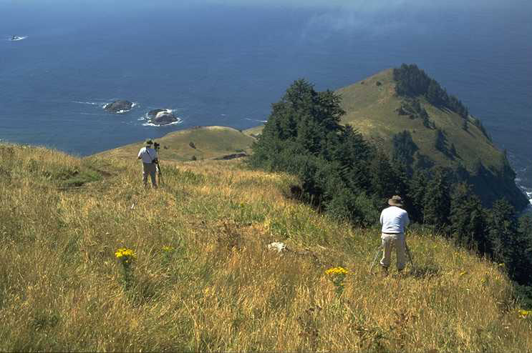

https://xkcd.com
H. J. Andrews Forest

Slide 2
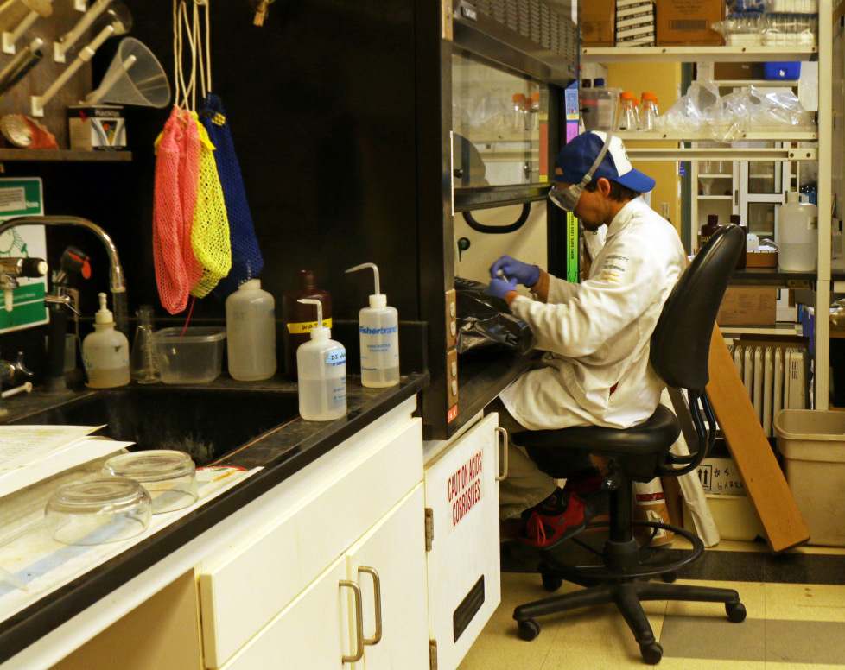
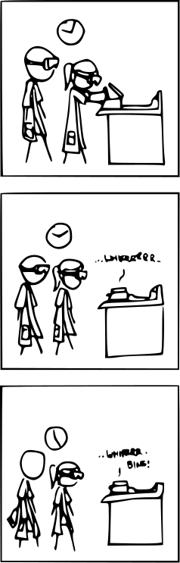
Santa Barbara Coastal LTER
https://xkcd.com

Slide 3
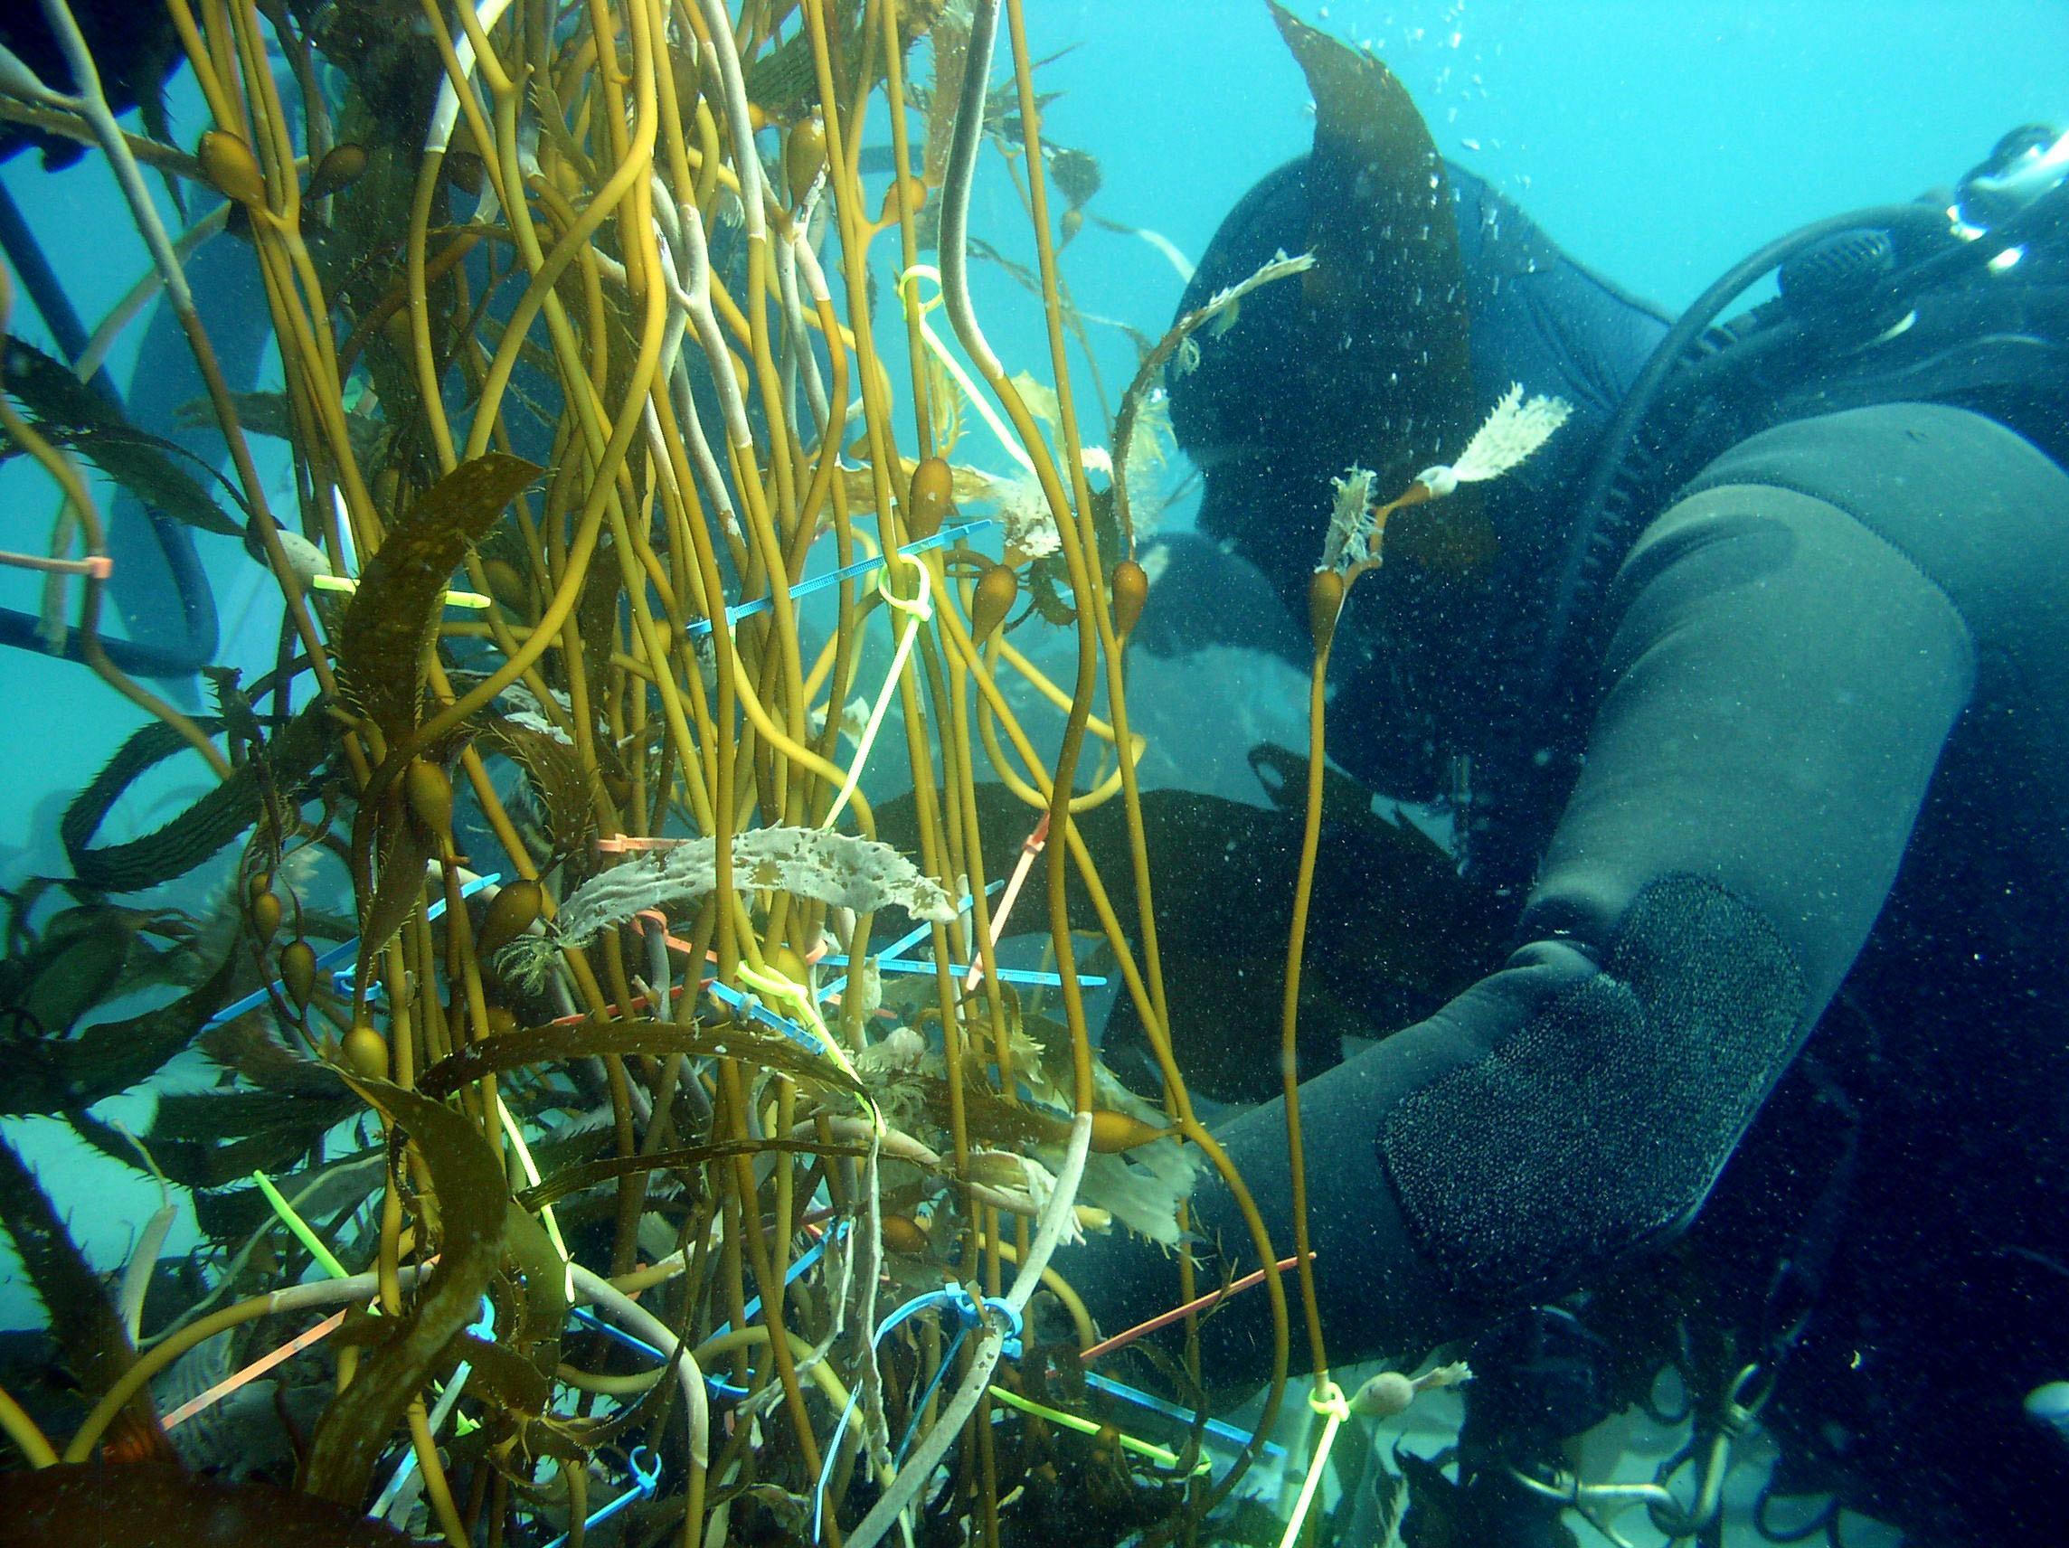

Slide 4

Publishing Your Data
is
Easier Than You Think
Margaret O’Brien, Corinna Gries, Kristin Vanderbilt, Colin Smith
https://EnvironmentalDataInitiative.org

Slide 5
Common goals
Data Managers
Scientists
Notes:
common goals

Slide 6
Common goals
Data are
COHERENT
COMPLETE
ARCHIVED
CITABLE
Data Managers
Scientists

Slide 7

1. ORGANIZE
2. CLEAN
3. DESCRIBE
4. UPLOAD
5. CITE

Slide 8

Step 1
ORGANIZE

Slide 9
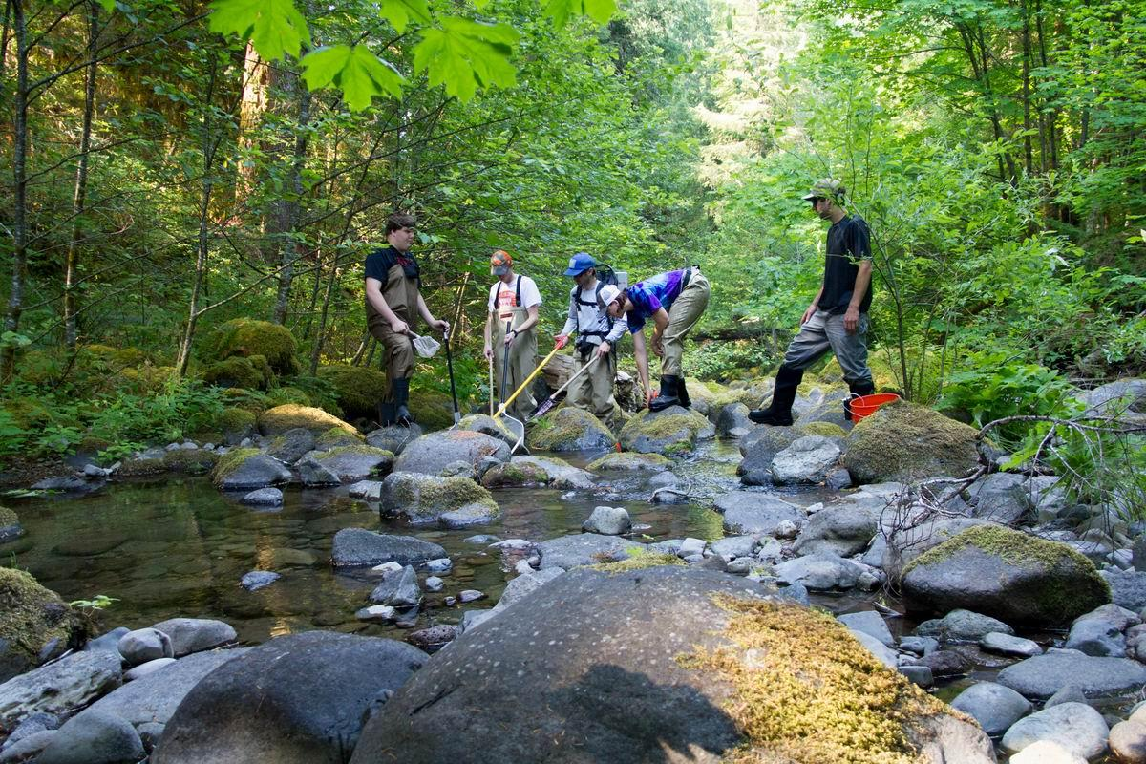
H. J. Andrews Forest

Slide 10

Step 2
CLEAN

Slide 11
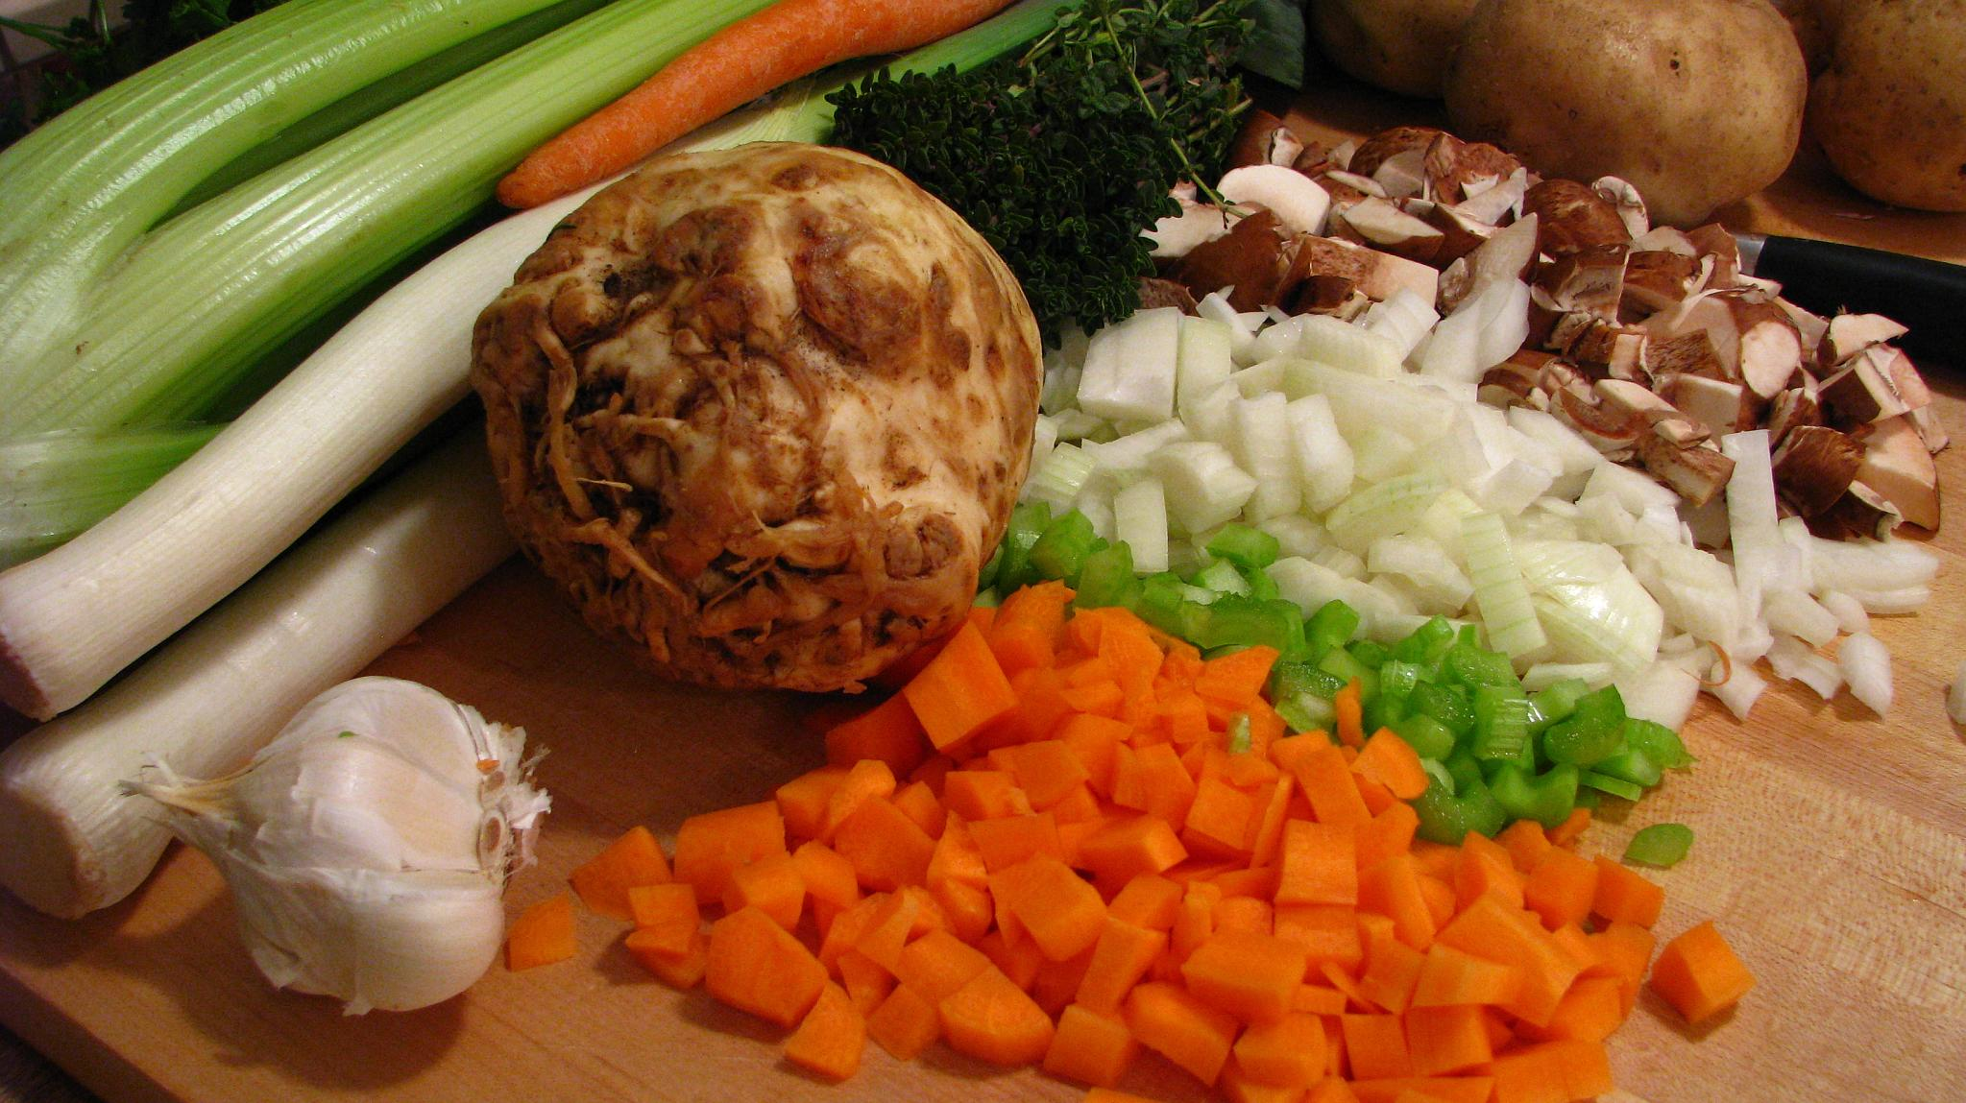
https://flickr.com

Slide 12
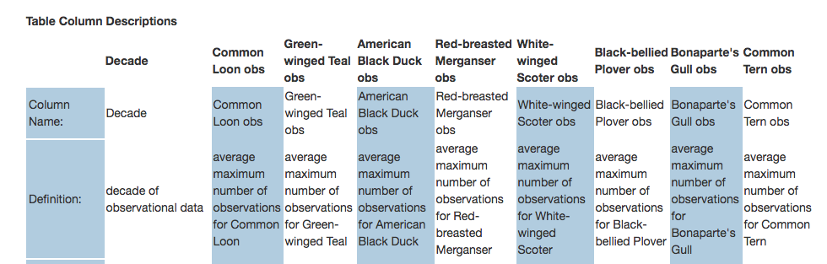
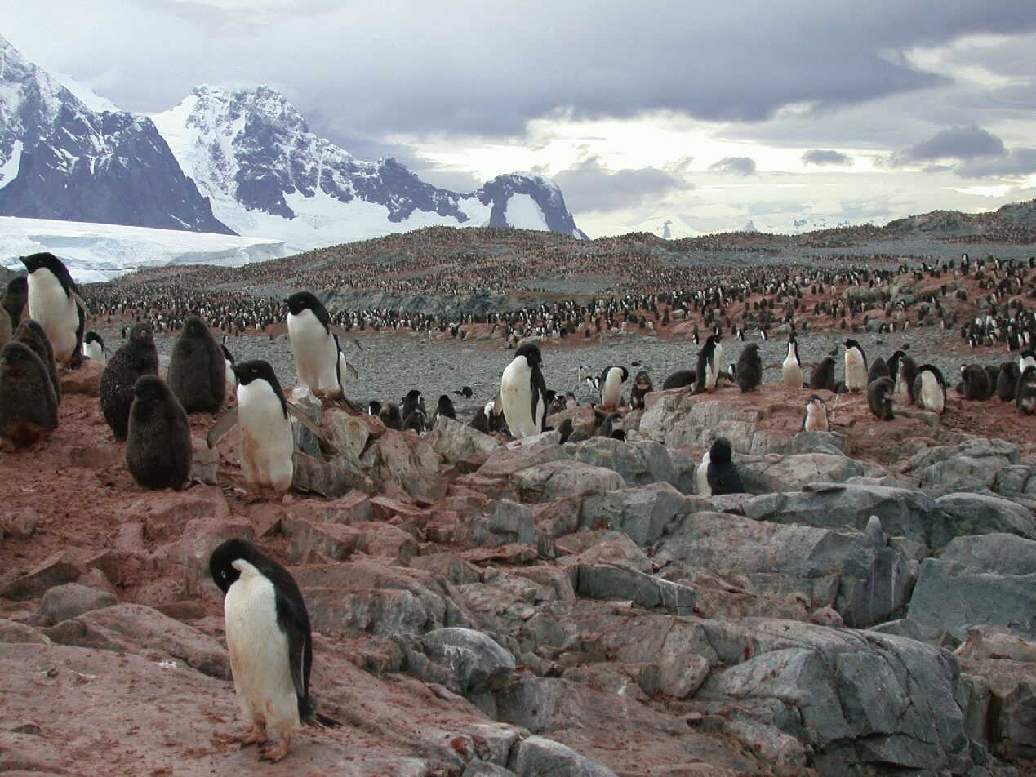
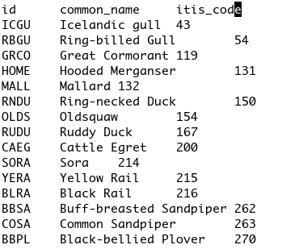
http://portal.edirepository.org
Palmer Antarctic LTER

Slide 13

Step 3
DESCRIBE

Slide 14
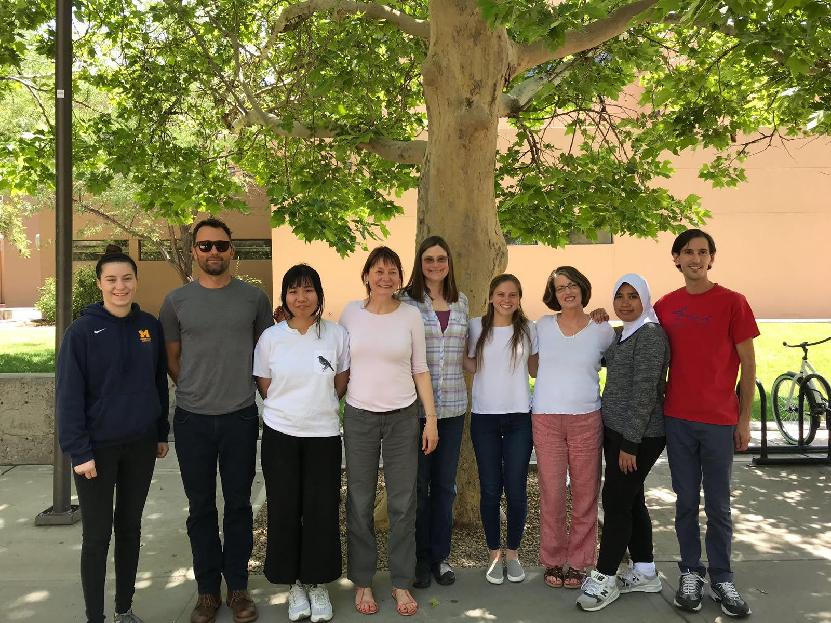

Slide 15
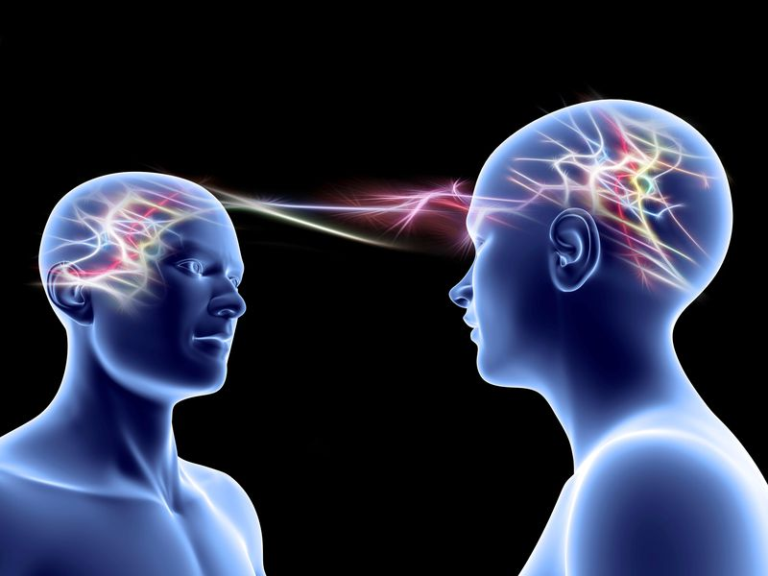

Slide 16


http://zazzle.com
https://xkcd.com

Slide 17

Step 4
UPLOAD
Looks good!

Slide 18
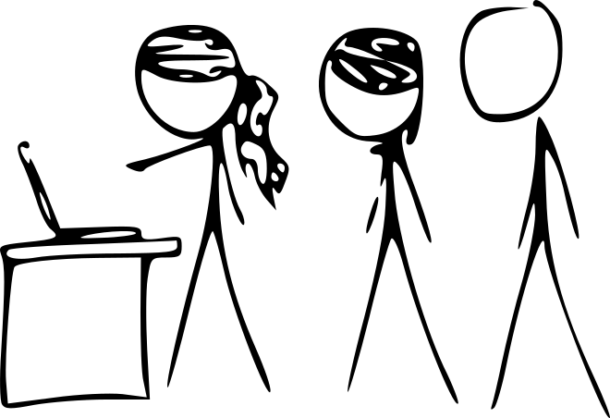
Step 5 CITE ...
H. J. Andrews Forest. https://lternet.edu/site-image-galleries/?site_id=1894 (accessed 2018-07-31)
Munroe, R. 2017. Birdwatching. http://www.xkcd.com/1826/ (accessed 2018-08-01)
Santa Barbara Coastal LTER https://lternet.edu/site-image-galleries/?site_id=1928 (sbclter_004.jpg, accessed 2018-07-31)
Munroe, R. 2010. Science Montage. https://xkcd.com/683/ (accessed 2015-10-15)
Santa Barbara Coastal LTER. https://lternet.edu/site-image-galleries/?site_id=1928 (sbc.ter_002.jpg, accessed 2018-07-31),
Munroe, R. 2013. Reassuring. https://xkcd.com/1263/ (accessed 2015-10-15)
H. J. Andrews Forest https://lternet.edu/site-image-galleries/?site_id=1894 (accessed 2018-07-31)
Munroe, R. 2014. Umwelt Disasters. https://xkcd.com/1037 (accessed 2015-10-15)
Pollyalida, 2014. Flickr. https://www.flickr.com/photos/pollyalida/2255162589 (accessed 2018-08-01)
Palmer Antarctic LTER. https://lternet.edu/site-image-galleries/?site_id=1924 (accessed 2018-07-31)
Environmental Data Initiative. 2018. https://environmentaldatainitiative.org/events/summer-2018-fellowship-program/ (summer_fellows_2018.jpg, accessed 2018-07-31)
Munroe, R. 2015. Code Quality. https://xkcd.com/1513 (accessed 2015-10-15)
Iozzio, C. 2014. Scientists Prove That Telepathic Communication Is Within Reach. Smithsonian Magazine. https://www.smithsonianmag.com/innovation/scientists-prove-that-telepathic-communication-is-within-reach-180952868/ (accessed 2018-07-31)
Munroe, R. 2015. Code Quality. https://xkcd.com/1513 (accessed 2015-10-15)
Anon. n. d. https://www.zazzle.com/i_cant_read_your_mind_trucker_hat-148139824027281385 (accessed 2018-07-31)
Munroe, R. 2012. Valentine Dilemma. https://xkcd.com/1016 (accessed 2018-07-31)
Munroe, R. 2010. Arsenic-based Life. https://xkcd.com/829 (accessed 2015-10-15)

Slide 19
... DATA, TOO
Nilon C. 2010. Baltimore Ecosystem Study LTER - Biodiversity - Fauna - Bird Survey Species List. Environmental Data Initiative. https://doi.org/10.6073/pasta/ea265b5b6a9ec977b28308543e7b0cc6. Dataset accessed 8/02/2018.
Buchsbaum R. 2004. Averages of the three highest counts per decade (1930 - 2000) for selected birds in Plum Island Sound. Environmental Data Initiative. https://doi.org/10.6073/pasta/5bfab70a25775e7dba7d4d5455f4b80e. Dataset accessed 8/02/2018.
Sonnier G., P. J. Bohlen, H. M. Swain, S. L. Orzell, E. L. Bridges, E. H. Boughton. 2018. A case study of the effects of wetland restoration on the hydrology, species diversity, species composition and floristic quality of restored wetlands within a Central Florida ranchland, 2003 - ongoing.. Environmental Data Initiative.https://doi.org/10.6073/pasta/b745934d136ce9ca8de26c5063eee86a. Dataset accessed 8/07/2018.

Slide 20
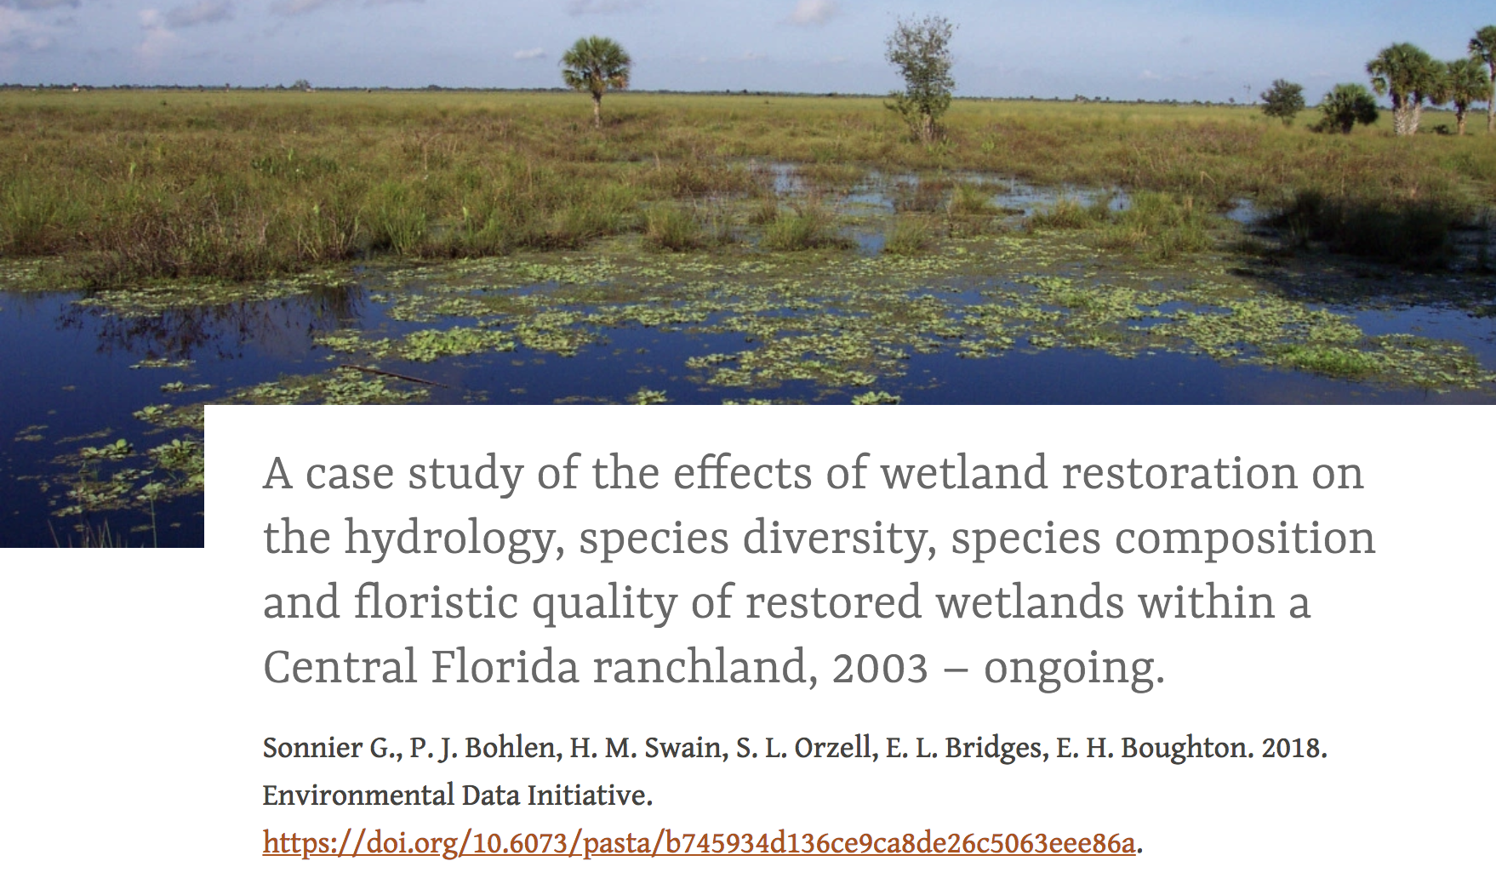
Nice!

