Slide 1
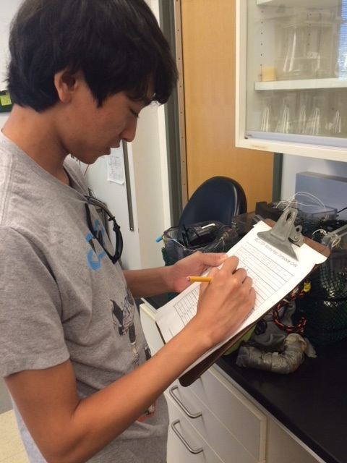
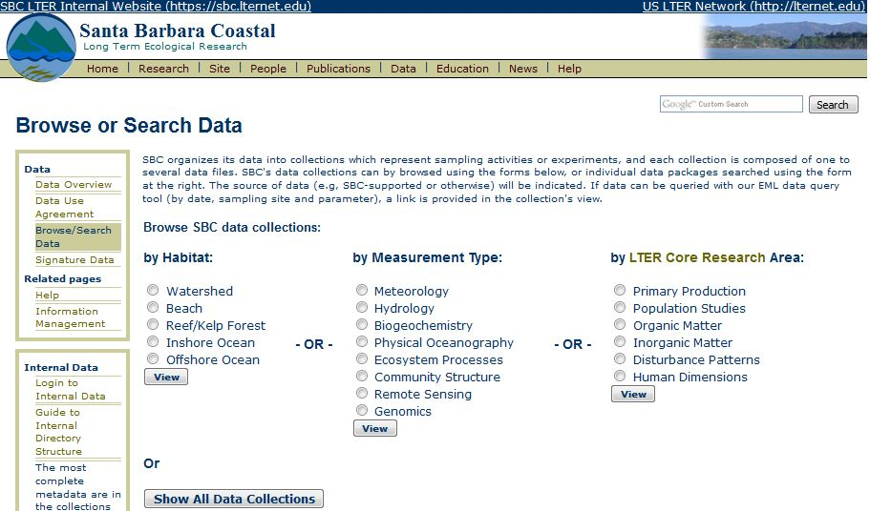
Integrating Information
Management with Research
Margaret O’Brien
Notes:
major commitments of an LTER site: catalog data for the long term, for archival and for uses we can’t anticipate yet
complex; multiple investigations going on simultaneously, virtually any kind of environmental data.
Data management at an LTER site is most often focused on that cataloging effort, and in keeping everything well organized, and available, both internally and for the public.
most effective: data management efforts are well connected to the research itself.
brief overview of how SBC connects research to the data cataloging process, and highlight a couple of features of our IM system

Slide 2
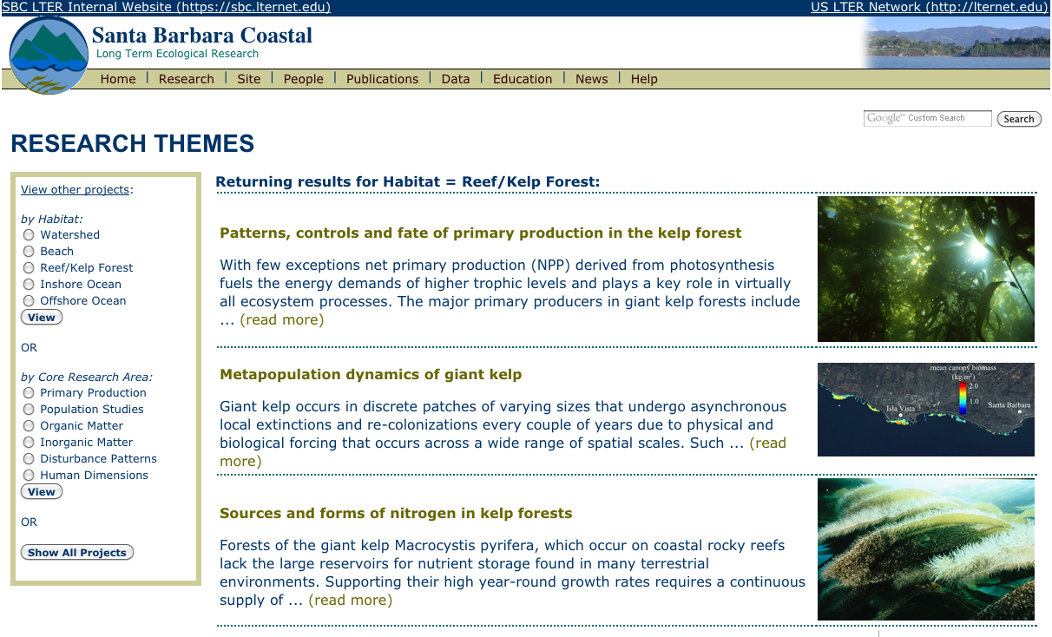
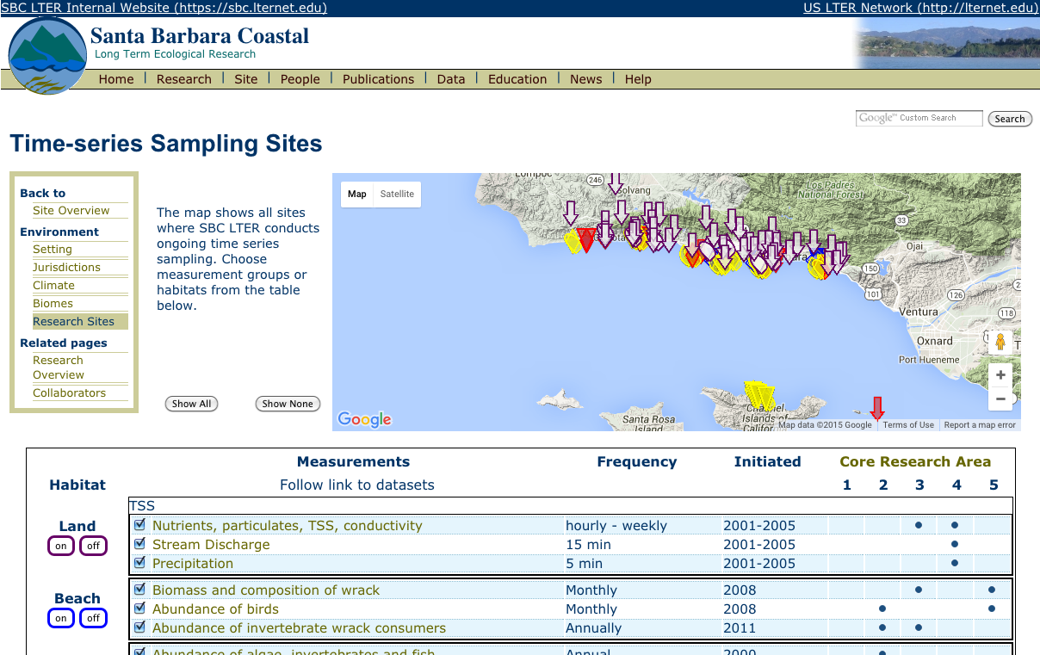
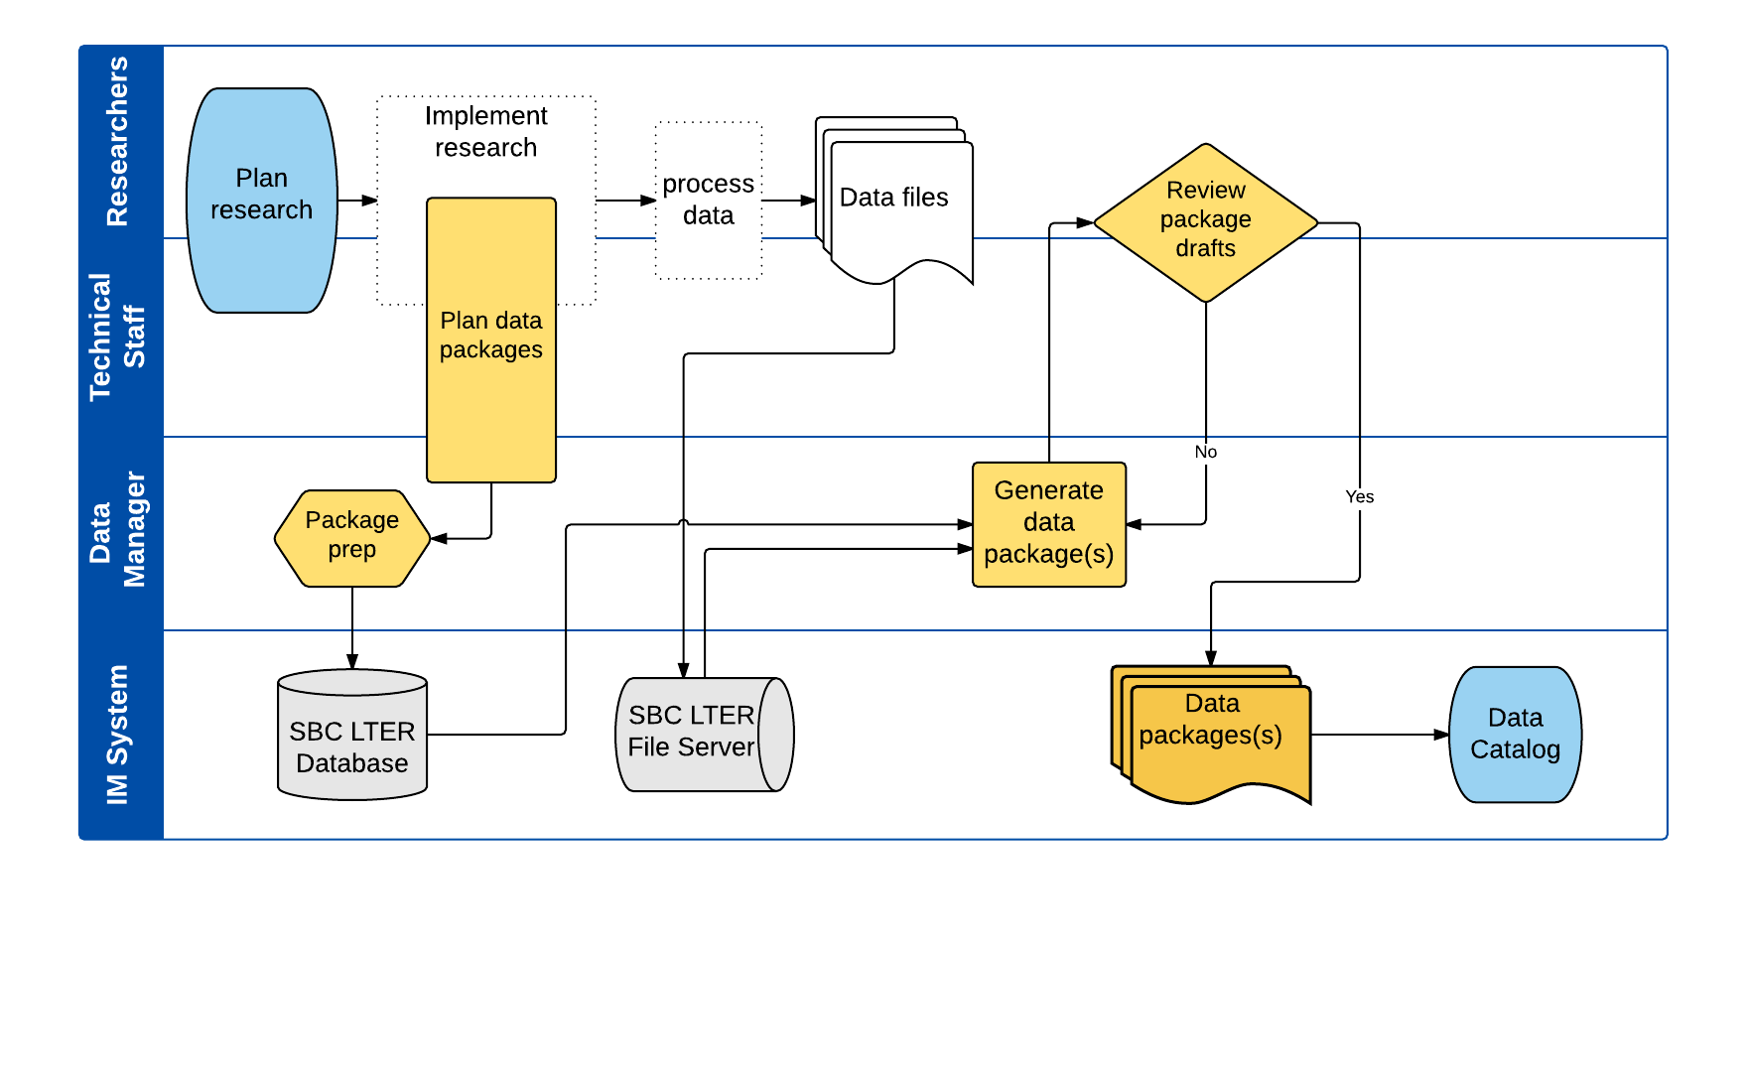
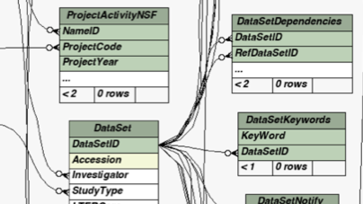
Outline
Data-related website features
Sites, Research, Catalog
How data get there
Data package design
SBC Information Management System
Overview of highlights
Notes:
3 levels of integration to show –
1. 10k foot view, basically, what is visible to the public, on the website.
2. processes we use for getting the data from the lab to the catalog and the web, This would be the view of an SBC scientist
3. focus on a couple of IM sys modules, and highlight how these have made our work more efficient, help connect data management to research efforts

Slide 3
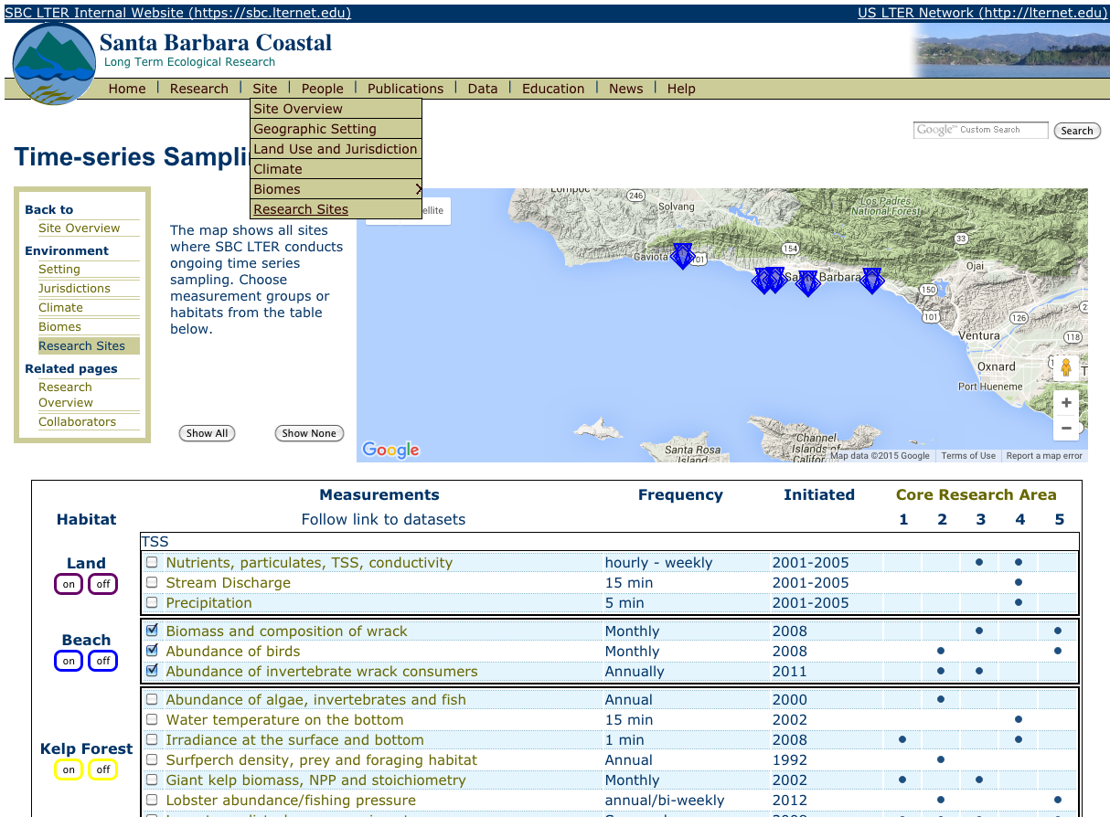
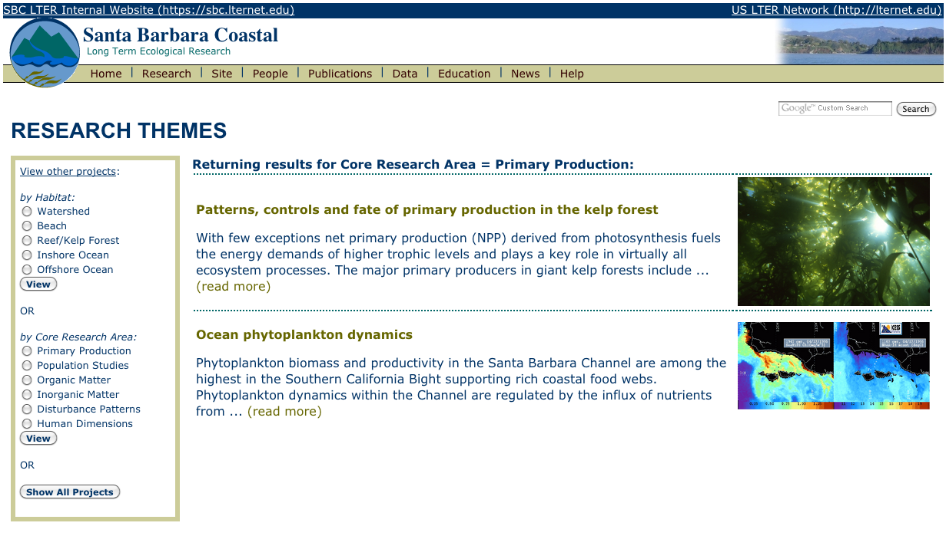
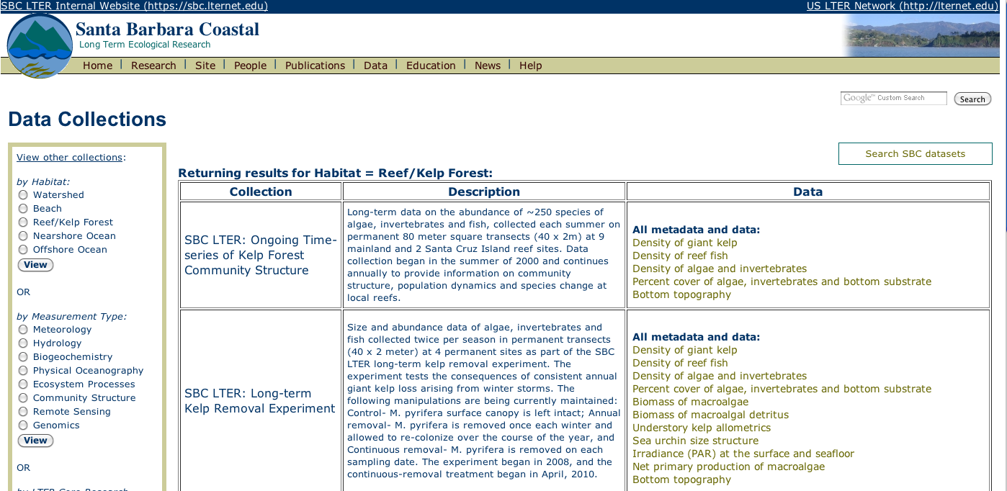
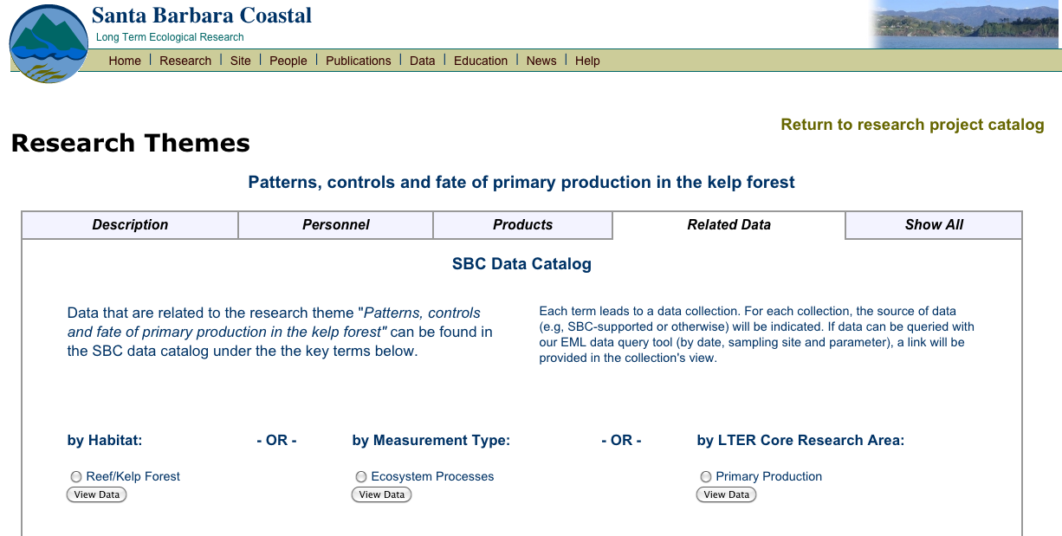
Data-related Website Features
http://sbc.lternet.edu
Research Index
Sampling Sites
Research & Sampling
Linked to Datasets
Datasets
Notes:
several pathways leading to data from different aspects of research
One the left area called “research themes”. browse specific research topics, read some high level descriptions, link directly to data related to those topics.
On the right, second pathway: We have a large number of ongoing time series. , screenshot is of the map application showing all long-term stations.
Each of these measurement collections is also linked directly to the data catalog.
The data catalog is based on keywords The website design is modular, so sections can be enhanced individually.
plan for growth in the types of research conducted, and the data we handle. Maintain consistency for returning visitors

Slide 4
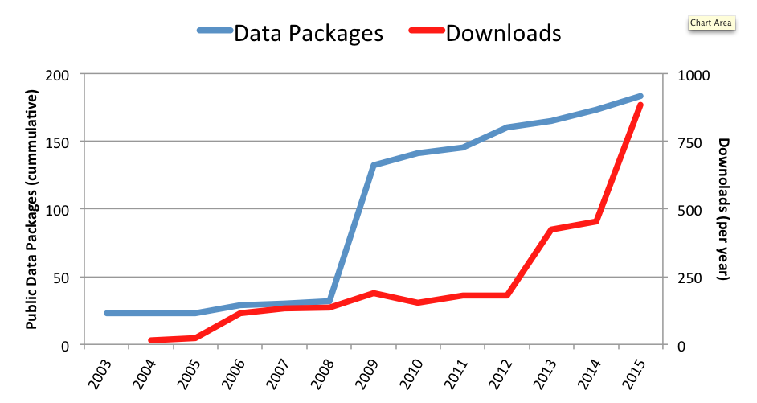
Data Holdings and Usage
(thru 9/2015)
190 data packages ~ 50% ongoing time-series
Notes:
TIMELINE
showing the growth in our corpus of data packages (the blue line), 2003 to this year.
almost 200 packages, more in pipeline. simple numbers - don’t show there are about 130 distinct types.
About half of all packages are ongoing time series. regularly reviewed for methods and formatting changes during updates
Our time series are single multi-year products, which is more work for us, but facilitates temporal analysis
The red line shows the number of downloads from the SBC data catalog. downloads Network add about 20% more. (not counted up quite the same way, nor for the same time period)
The growth of our holdings is clear, and in recent years, the number of downloads has increased quite rapidly.
[ Only talking about data sets here. other stuff includes
User accounts – about 200
1100 biblio entries (about half peer-reviewed)
Multiple websites under sbc.lternet.edu
About 1 TB on the file server, hosted by MSI
The IM system has to keep up with that activity. What does it take to get this amount and variety of data into a catalog?

Slide 5
How Data Get There Basic Research Process
Notes:
“SWIM LANE”: the participants are over here on the left. time moves along to the right no units)
The rectangles represent different processes, and they go into the lane of the participant who does those tasks.
Here: a process you are all familiar with - how research is generally conducted.
SCIENTISTS work alongside the TECHNICAL STAFF (who are usually scientists by training) to PLAN and IMPLEMENT research, then PROCESS data to produce a group of DATA FILES.
Simplified - so that we can add in the data cataloging components: And When we add that, the process looks like this...
NEXT

Slide 6
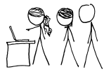
Data Cataloging Process
Notes:
more lanes:, for the DATA MANAGER, and the BOTTOM one, which is mostly HARDWARE.
Now, SCIENTISTS/STAFF and DATA MANAGER collaborate on the planning of a data package. Pkg = data files + metadata
we call this “DATA PACKAGE DESIGN”.
not one-size-fits-all. The process is iterative, and if the data are complex, it can sometimes take a fair amount of time.
iterative, and ideally, is started early. Sometime it happens during PLANNING
most often, after some implementation - for instance, an instrument has been deployed and some of the data examined and the settings finalized.
some support services: FILE SERVER, matlab server and code repository,
we can help you plan your processing [DATA FILES]. And by being involved early, the data manager can start a record in the DATABASE, and have some possible templates in mind for later.
generate a “DATA PACKAGE”
when data files are ready, we generate a “DATA PACKAGE”,. Metadata can be complex, data manager = bridge between you (the scientists) and those requirements. The SCIENTISTS (because you're the ones with intellectual control) REVIEW the final product before it’s CATLOGED.
DataONE aggregates metadata, also queried by BCO-DMO.
If ongoing
maintenance plan. Often for a time series, this means –Instrument additions, –Methods changes, –Sites added/removed (or other new metadata)
Revisit "PLAN DATA PACKAGES"
Example: recently added pH instruments to our moorings for the study of the ocean carbon cycle, designed datasets specifically for those instruments.
O2 sensors: went out during the past year.
Integrating that data will take us back to the “PLAN DATA PACKAGES” step . Also affects ADCP and CTD moorings (ph is colocated).

Slide 7
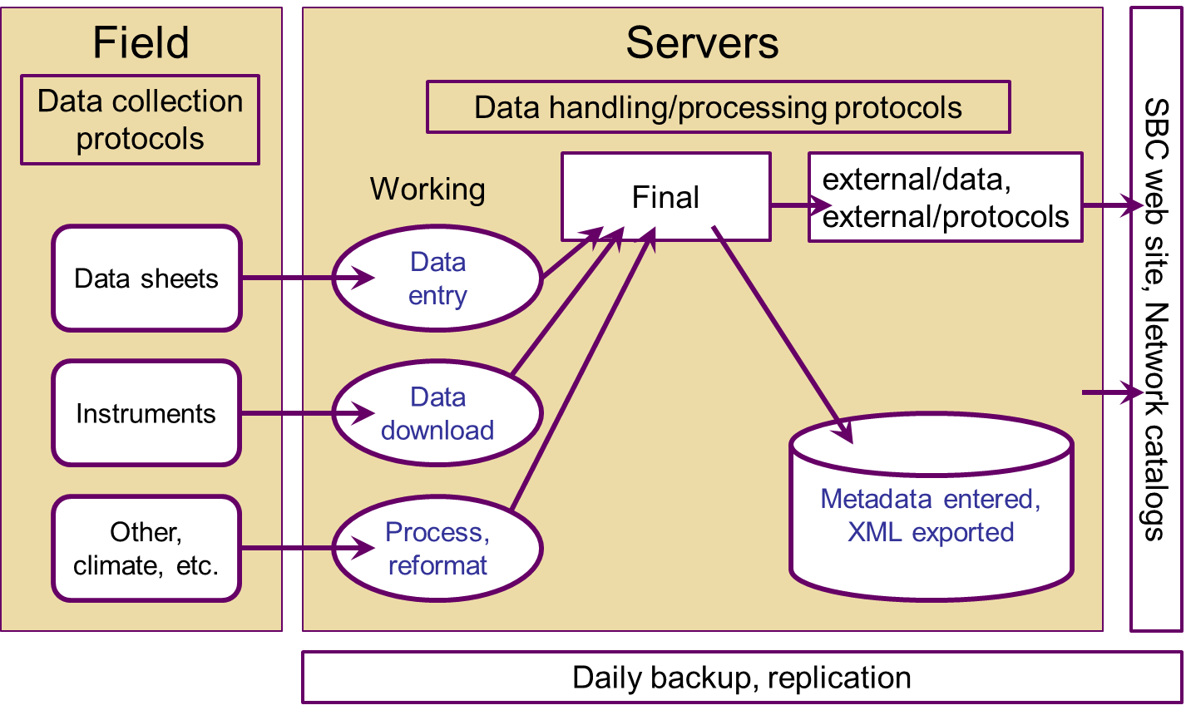
SBC Information Management System Collection to Distribution
Notes:
(Back to support services. )
slightly more detailed view of the process of getting data onto the file server. On the LEFT, is all that field work, and other ways of gathering [whatever].
On the file SERVER, each research group has 2 major areas: WORKING and FINAL.
Convention: data comes in to the WORKING area, but that only data that is ready to be shared should go into the FINAL area.
Anyone with an SBC login can browse these areas and view or download data. But only the people who are responsible for processing can write there.
FINAL = ready to be shared.
data manager: can monitor for changes. To build metadata records in the DB and push out XML to the SBC web and network catalogs.

Slide 8
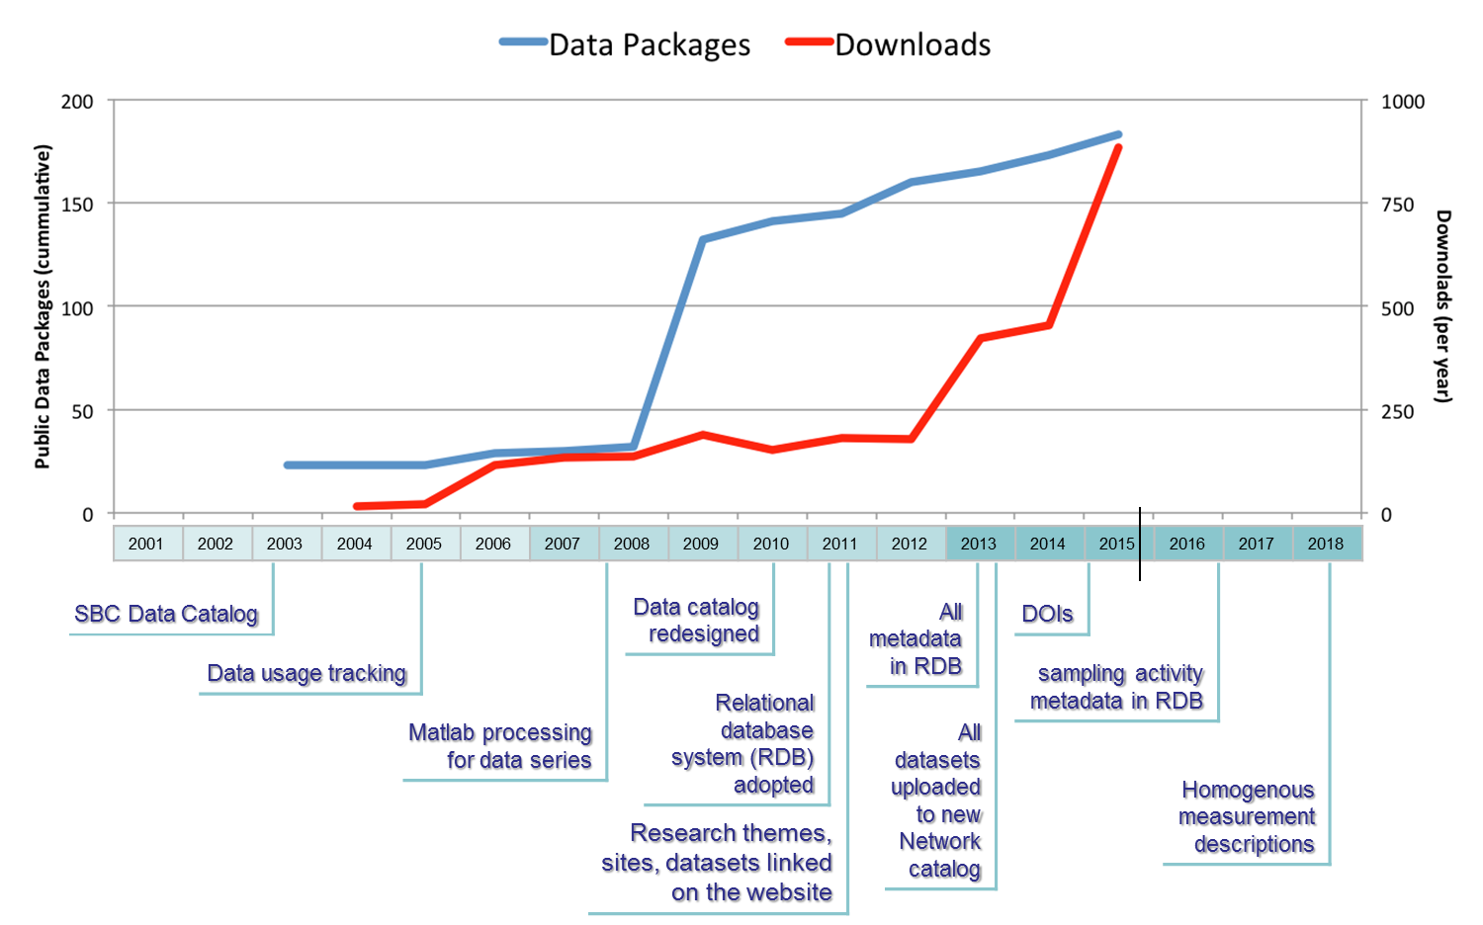
SBC Information Management System Timeline
Notes:
HOLDINGS + TIMELINE.
So now, you have an understanding of what kinds of data we have, and how data gets into the catalog - so, what are the IM system components that we need to accomplish that?
Here again, is that plot showing the growth of our data holdings and usage.
Timeline with some of the major IM System milestones
color changes represent the 3 core grants in 2001, 2007 and 2013. There is a line there near the end of 2015.
Our IMS : modular, : components can be upgraded or swapped out without affecting other parts. The boat stays afloat. Some older components re still perfectly viable and adaptable.
Next: highlight just a few IMS components, and how these work to improve the integration we already have, and set up the goals we have for remainder of SBC III.
RELATIONAL DATABASE SYSTEM: is central now.
ported the model from GCE, 2011 and migrated all the dataset metadata.
tilll then, all metadata was handled mostly manually. OK for a small corpus, but doesn't scale.
I'll give you 3 examples of how the RGB works with other IM syst components.

Slide 9
SBC Information Management System Highlight 1
Relational database (RDB) adopted
Data catalog redesigned
Inventory management with draft views
2001 | 2002 | 2003 | 2004 | 2005 | 2006 | 2007 | 2008 | 2009 | 2010 | 2011 | 2012 | 2013 | 2014 | 2015 | 2016 | 2017 | 2018
SBC Data Catalog
Data usage tracking
Matlab processing for data series
Research themes, sites, datasets linked on the website
Relational database system (RDB) adopted
Data catalog redesigned
Metadata in RDB
All datasets uploaded to new Network catalog
DOIs
sampling activity metadata in RDB
Coherent measurement descriptions
Notes:
having a central relational database model means that we can build more flexible views than we could before.
We had already redesigned the data catalog code back in 2010 ...
We can use these together, we have an inventory system that can track and display draft views

Slide 10
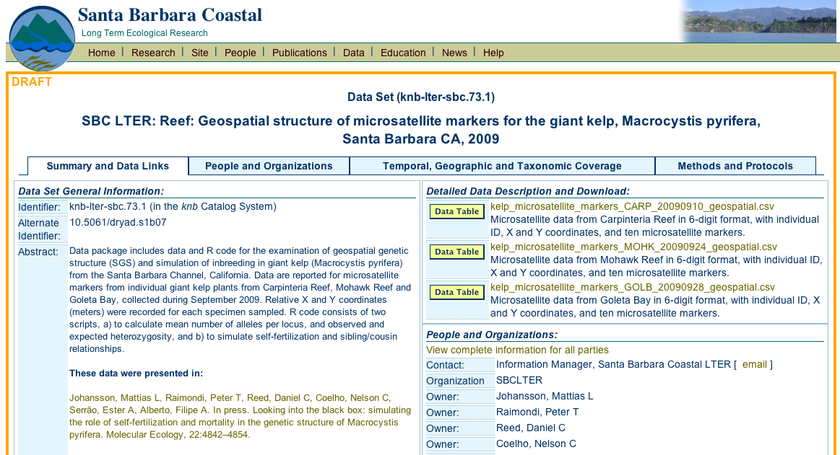
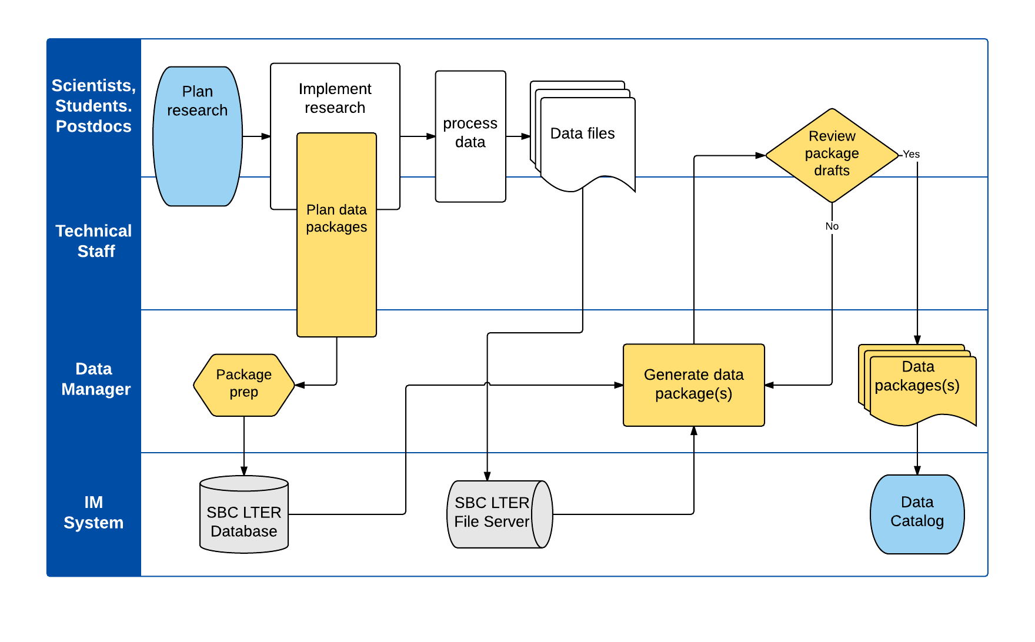
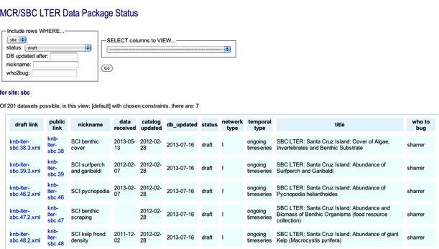
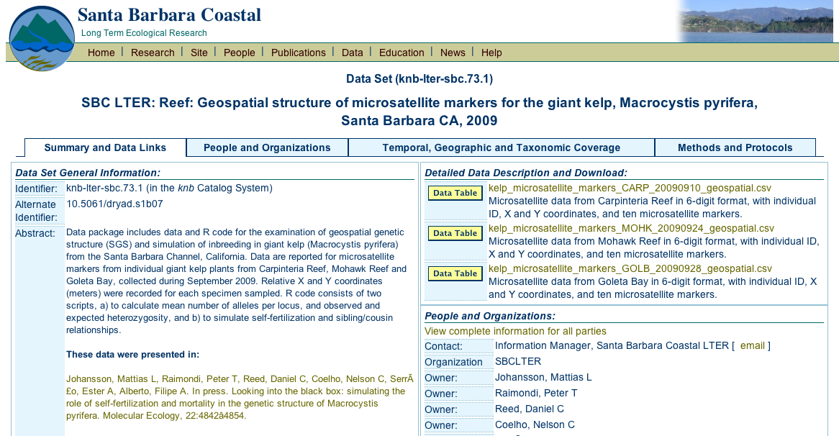
Inventory Management, Draft Views
Data catalog redesigned
Relational Database
Draft view
Catalog view
Inventory
Notes:
example RDBMS + showdraft = inventory
So now, INVENTORY SYSTEM makes it much easier to keep track of the status of draft datasets.
This comes into play for the data manager in the early stages, [LEFT RED].
For a scientist REVIEWING DRAFT dataset [RIGHT RED], the draft view [TOP-RIGHT RED] is identical to the one in the final catalog.[BOTTOM RIGHT RED]

Slide 11
SBC Information Management System Highlight 2
RDB streamlined Matlab processing
Allows data package production by technical staff
2001 | 2002 | 2003 | 2004 | 2005 | 2006 | 2007 | 2008 | 2009 | 2010 | 2011 | 2012 | 2013 | 2014 | 2015 | 2016 | 2017 | 2018
SBC Data Catalog
Data usage tracking
Matlab processing for data series
Research themes, sites, datasets linked on the website
Relational database system (RDB) adopted
Data catalog redesigned
Metadata in RDB
All datasets uploaded to new Network catalog
DOIs
sampling activity metadata in RDB
Homogeneous measurement descriptions
Notes:
RDB + matlab processing = somebody else can do it.
2008: matlab code for processing of datasets with templates. (ex: stream discharge and precipitation, instrument data like moorings and pH).
One reason for choosing matlab was that a lot of laboratory processing also uses it also, so ...
so now, we are set up to tie the dataset production process more closely to the processing steps.
Here is that process SWIM LANE again, and we could transfer that “GENERATE DATA PACKAGES” box to the technical staff, instead of being performed only by a data manager.

Slide 12
SBC Information Management System Highlight 3
Homogenizing measurement descriptions and sampling activities (ongoing)
Leads to sophisticated linkages and improves functionality
2001 | 2002 | 2003 | 2004 | 2005 | 2006 | 2007 | 2008 | 2009 | 2010 | 2011 | 2012 | 2013 | 2014 | 2015 | 2016 | 2017 | 2018
SBC Data Catalog
Data usage tracking
Matlab processing for data series
Research themes, sites, datasets linked on the website
Data catalog redesigned
Relational database system (RDB) adopted
Metadata in RDB
All datasets uploaded to new Network catalog
DOIs
Sampling activity metadata in RDB
Homogeneous measurement descriptions
Notes:
Remainder of SBC-III: focus on additional linkages to improve functionality.
RDB will help here, 2 areas:
First - we plan to homogenize the measurement descriptions within SBC project.
Includes analysis methods, precision, and dimensions.
dataset metadata kept centrally, and in a good relational model -> it’s much easier to monitor the content, look for patterns, and then apply constraints.
Secondly, now that we have literally hundreds of datasets, some of the search features on the website are a little overloaded. We want to modernize some of the earlier modules that the website uses, and make it a little more flexible, and easier to maintain.
The result: comprehensive descriptions of measurements, sampling and methods
better linkages within the SBC website, and also
better integration of our data with that of other research programs. this will also
let us take advantage of some new informatics tools being developed by groups like earth cube.

Slide 13
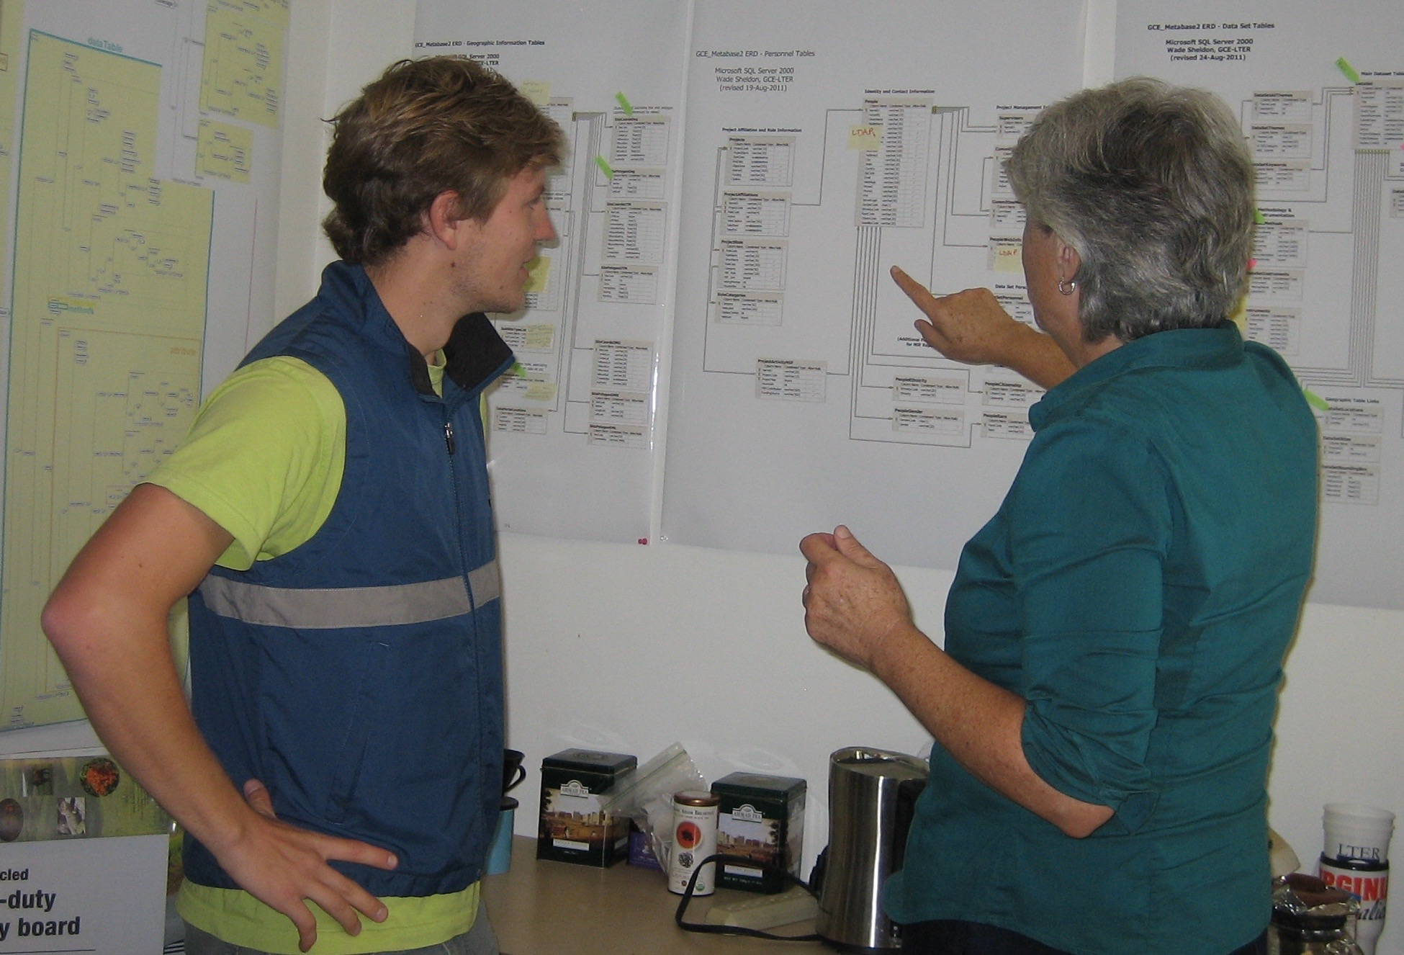
Questions?

