Slide 1

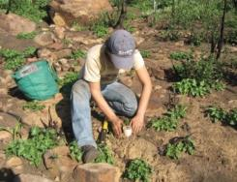
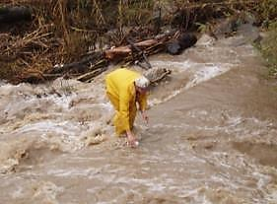
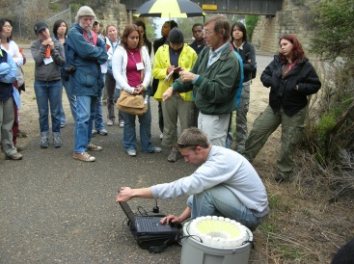
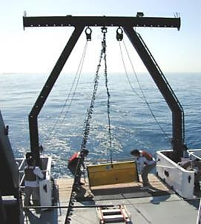
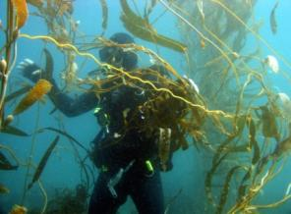
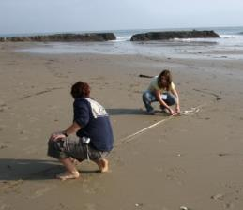
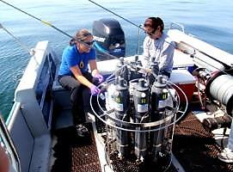
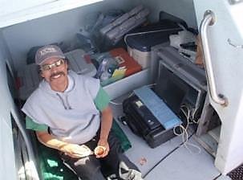
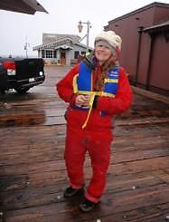
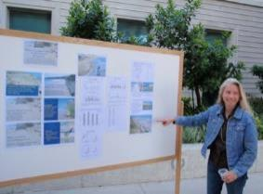
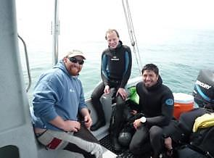
Santa Barbara Coastal
Long Term Ecological Research program
2015 Midterm Review
Marine Science Institute
University of California Santa Barbara

Slide 2
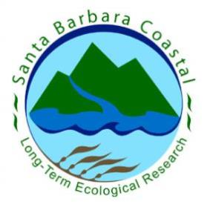

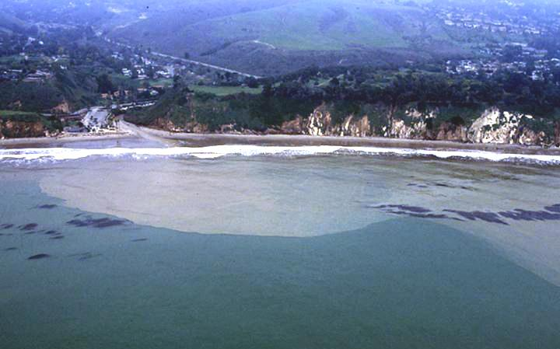
SBC LTER
Established April 2000
Research Focus: Role of land and ocean processes on the structure, function and dynamics of coastal marine ecosystems
Notes:
SBC was established in April 2000 at a time that NSF was interested in expanding the LTER Network to include coastal ecosystems at the land-ocean margin.
Hence the research focus of SBC LTER is on the role of land and ocean processes on the structure, function and dynamics of coastal marine ecosystems.

Slide 3

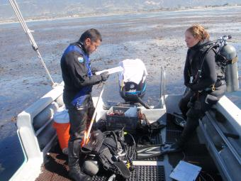
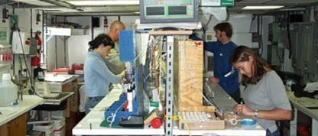
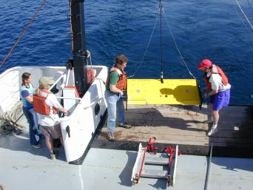
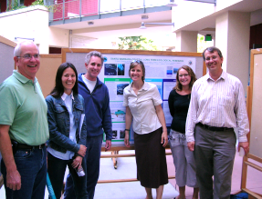
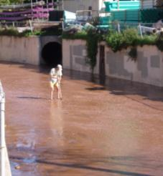
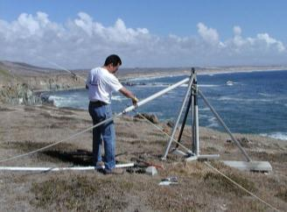
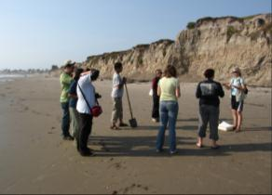
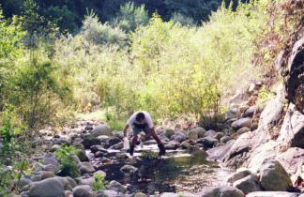
Santa Barbara Coastal
Long Term Ecological Research
Who we are
30 Investigators
3 Post docs
24 Graduate students
~50 Undergrads
10 Research staff
1 Data manager
3 Education/outreach staff
Science disciplines include:
ecology, biological and physical oceanography, physiology, genetics, hydrology, geography, geology, and history

Slide 4
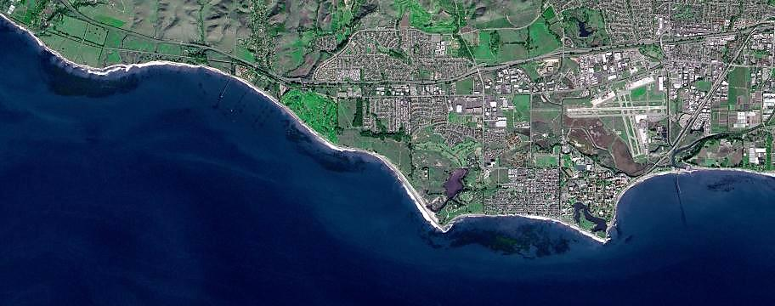
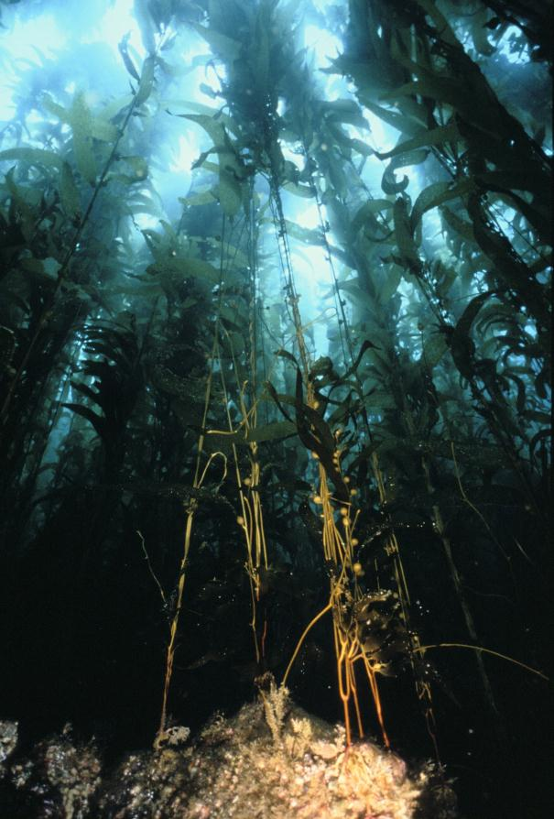
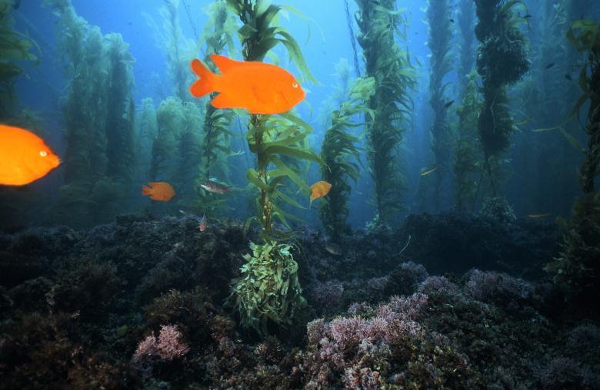
Giant kelp forests are the focal ecosystem of the Santa Barbara Coastal LTER
UCSB
Giant kelp forests
Notes:
Submarine forests of giant kelp are the focal ecosystem of SBC LTER
they occur along a narrow margin of the coast,
are of high ecological and economic importance
and are influenced by natural processes and human activities occurring on land and in the sea.

Slide 5
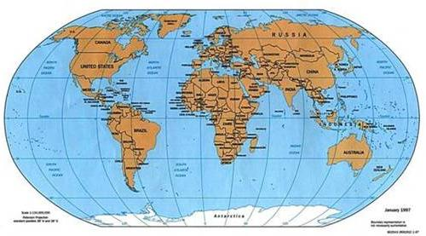
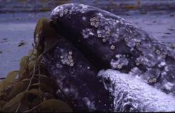
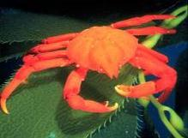
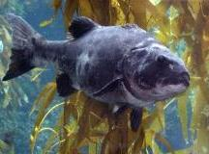
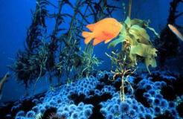
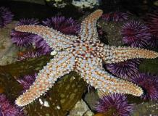
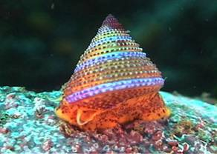
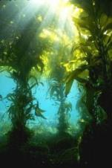
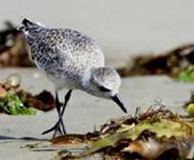
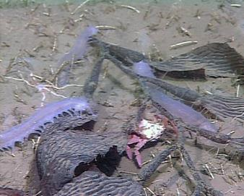
Attributes of Giant Kelp Forests
Worldwide distribution
Macrocystis pyrifera
Provide food & habitat for important species
High productivity
Material exchange with other ecosystems
Annual NPP
1110 m depth
Notes:
Giant Kelp forests
form the dominant community on shallow rocky reefs in temperate regions throughout the world.
Extremely fast growth rates, high biomass turnover result in them being one of the most productive and dynamic ecosystems within the LTER Network and the world in general.
Provide food and shelter for a wide variety of species many of which are both ecologically and economically important
Provides a major source of organic matter for adjacent beach and deep water ecosystems

Slide 6
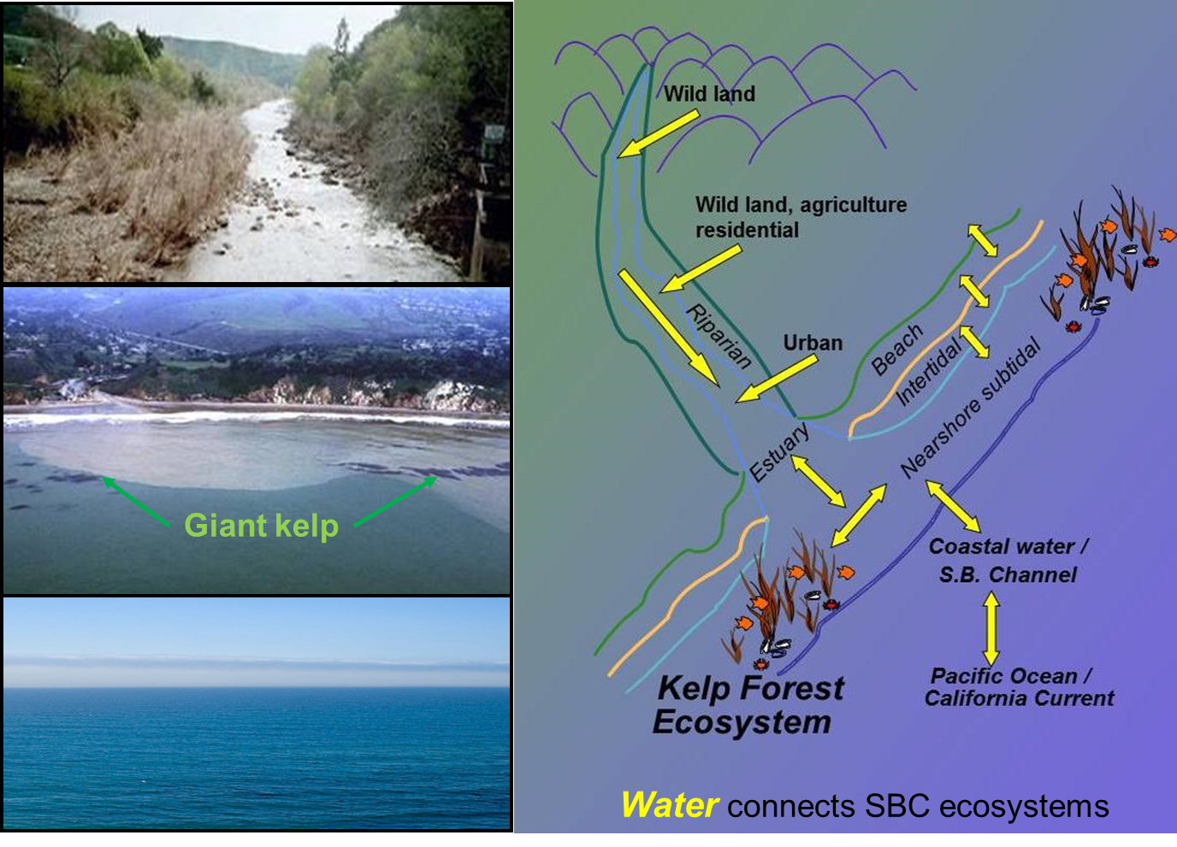
SBC overarching theme: Ecosystem Connectivity
Notes:
The overarching theme of SBC’s research and education programs is on ecosystem connectivity which occurs via the movement of water shown as the yellow arrows in this illustration.
Consequently, understanding the movement of water on land and in the ocean and of the materials that are transported by it is an integral part of SBC research.
Streams and rivers transport nutrients, dissolved and particulate organic matter, sediments and pollutants from land to coastal marine habitats,
In the ocean currents, winds, waves and tides transport dissolved nutrients, plankton, propagules and other forms of living and dead organic matter along shore, across the shelf from offshore waters to shore, and vertically in the water column from surface waters to the sea floor.
Short and long-term changes in climate that alter rainfall, winds, waves, ocean currents, and the depth of the thermocline as well as human use of terrestrial and marine resources may cause a change in the importance of land and ocean processes in exchanging materials among coastal marine ecosystems.
For instance El Ninos in our region are typically characterized by altered currents, low nutrients, large waves and high precipitation and runoff and the intensity and frequency of El Ninos varies with longer-term climate oscillations.
These types of dynamics are best captured with long-term studies.

Slide 7
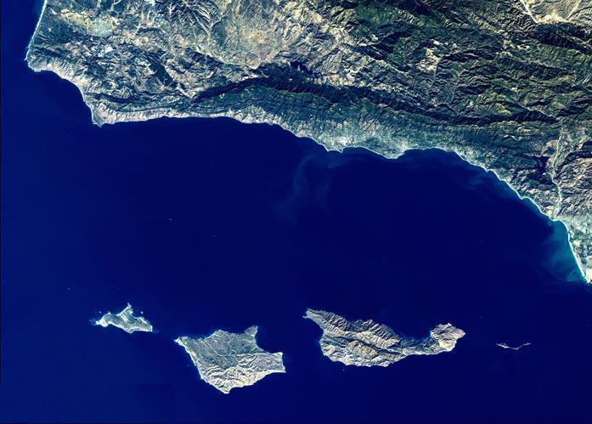
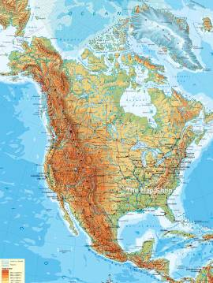
Santa Barbara Coastal LTER
UCSB
Santa Barbara Channel
Site Characteristics
~ 10,000 km²
Coastal mountains
Offshore islands
Major biogeographic boundary
Mediterranean climate
Small streams and estuaries
Beaches, shallow rocky reefs, kelp forests
Strong ENSO and PDO signal
Notes:
Located in southern California ~ 150 km north of Los Angeles.
Site encompasses 10,000 km2 and is characterized by a coastline that is oriented in a east/west direction
It is bounded by the Santa Ynez Coastal Range to the north, the offshore Channel Islands to the south, the Santa Clara River to the east and Pt. conception to the west
Point Conception – Biogeographic boundary and the SB Channel has a rich history of oceanographic and ecological study
The region has a Mediterranean climate with seasonal rainfall that is delivered in rapid bursts during a few months of the winter
The coastal watersheds are characterized by small streams and estuaries
While the shallow coastal zone features rocky reefs that are dominated by giant kelp forests
Climatic signals such as El Nino Southern Oscillation and the Pacific Decadal Oscillation are prominent in the region and greatly influence a wide variety of ecological processes occurring on land and in the ocean

Slide 8
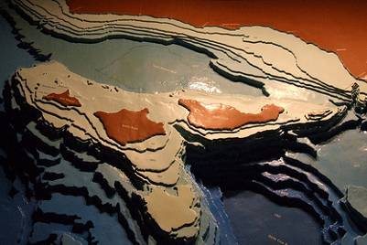
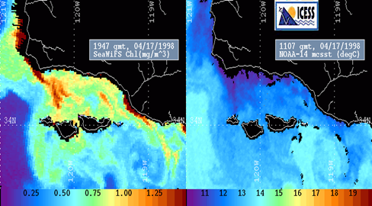
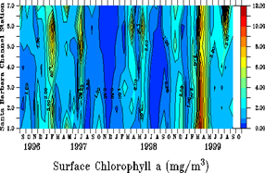
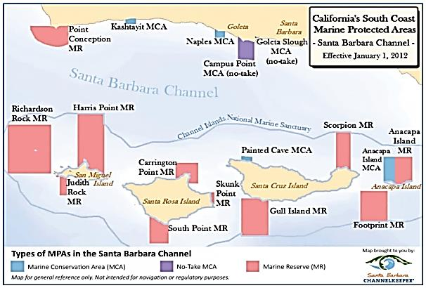
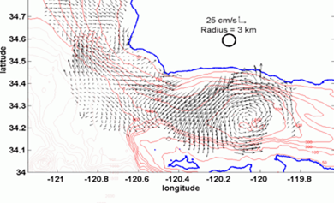
Marine Attributes of SBC LTER
Santa Barbara
7
Santa Barbara Basin
609 m
6
5
*
*
1
*
*
4
*
*
*
*
*
*
3
*
*
7
*
2
*
1
High topographic relief
Strong gradients in space and time
Santa Barbara
Complex circulation
System of no take marine reserves
Notes:
High topographic relief is characterized by narrow shelf, offshore Channel Islands and a deep anoxic basin located in mid channel. The varved sediments in the deep anoxic basin offer one of the highest resolution data sets available of climate change over the past 100,000 years.
East-west orientation of the coast contributes to the complex circulation patterns in the SB Channel that are characterized by a seasonally variable central gyre created by the intersection of the cold southward flowing California Current and the warm , northward flowing southern California Counter Current.
This circulation results in a seasonally variable temperature and nutrient regime with cold relatively nutrient rich waters in the western channel and relatively warm nutrient –poor waters to the east
Complex circulation and strong gradients couple with the biogeographic boundary at Pt Conception results in a relatively high diversity of species with both northern and southern affinities
Network of no take reserves was recently established around the Channel Islands which have designation as a National Park and a National Marine Sanctuary. California’s recent MLPA added to this by establishing no take reserves along the mainland with several in the SB Channel

Slide 9
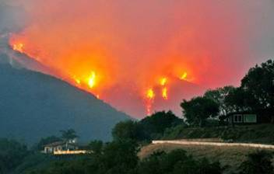
Land Attributes of SBC LTER
Diverse watersheds with steep slopes
Varied land cover
Episodic stream flows
Periodic fires
Notes:
The land attributes of SBC are typical of many semi-arid coastal regions in that they include a large number of watersheds that vary in size, land cover and land use.
Steep slopes (1200 m change in elevation over a couple km)
Seasonal winter rain result in episodic runoff
Periodic fires during the dry seasons, especially during years of low rainfall
All of these factors interact to affect the concentrations and rates of nutrients, organic matter, and sediments delivered to the coastal ocean

Slide 10
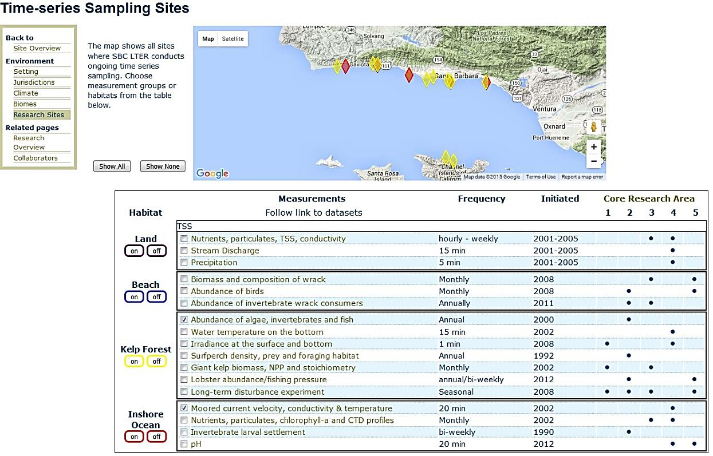
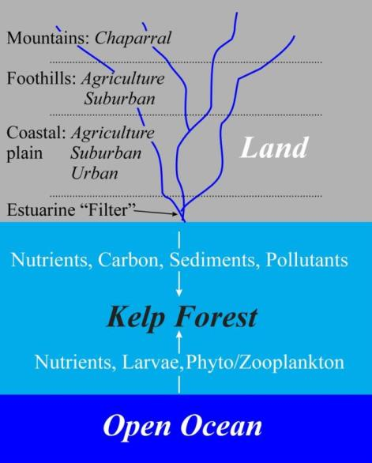
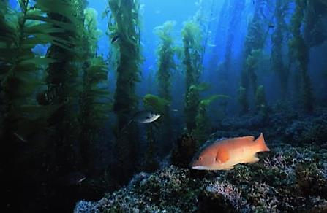
SBC I: 2000-2006
Develop long-term data sets of the 5 core areas of LTER research
Document patterns and sources of variation in kelp forest structure and function
Identify and quantify sources of material exchange among ecosystems

Slide 11
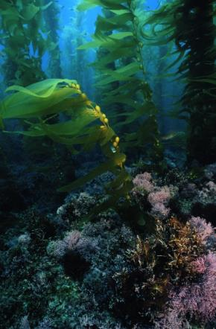
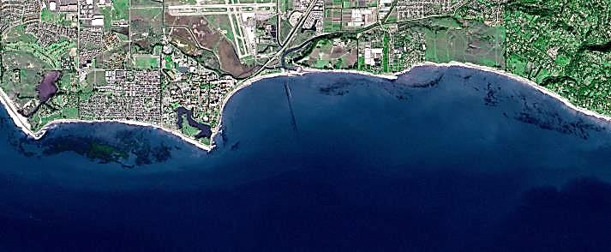
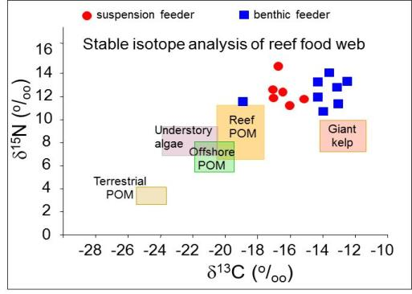
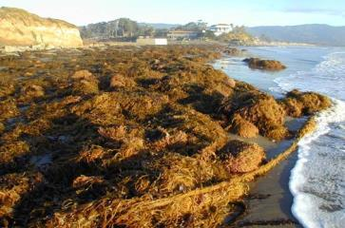

Key Findings from SBC I – Kelp forests
Patches of giant kelp function as a metapopulation
Rapid growth and turnover account for high NPP
Variation in biomass not growth accounts for high interannual variation in kelp NPP
Reed et al. 2006 Marine Metapopulations
Reed et al. 2008 Ecology
Kelp and phytoplankton fuel reef foodweb
Kelp subsidizes beach foodwebs
Dugan et al. 2003 Estuar. Coast. Shelf Sci.
Page et al. 2008 MEPS

Slide 12



Key Findings from SBC I – Coastal Ocean
Bassin et al. 2005 Geophys. Res. Let.
DIN source | μmol L⁻¹ d⁻¹
Winter upwelling | 1.0
Spring upwelling | 1.9
Internal waves | 0.3
Terrestrial runoff | 0.3 – 1.5
Upwelling , eddies, internal waves and runoff identified as major sources of nutrients to inner shelf
McPhee- Shaw et al. 2007 L&O
Kelp alters flow to affect the delivery and retention of material subsidies
Gaylord et al. 2007 L&O
Mohawk kelp forest
Upwelling bloom: June 12 , 2004
Coastal plumes: April 6 , 2006
Sediment plumes in SB Channel linked to runoff and phytoplankton blooms linked to upwelling
Otero and Siegel 2004 Deep Sea. Res.

Slide 13




Key Findings from SBC I - Watersheds
Nutrient fluxes and volumes in runoff linked to land use
Nutrient fluxes and concentrations in streams vary greatly within and among runoff events
10000
1000
100
Nitrate flux (mol ha⁻¹)
10
1
0.1
Greenhouse
Nursery
Commercial
Residential
Avocado
Chaparral/Forest
Melack and Leydecker.2005 Ver. Limnol.
Robinson et al. 2005 Ag. Water Man.
Hydrological modeling showed:
Most of the annual fluxes occur during a single storm
Urbanization increases peak discharges and volume while decreasing variability
Beighley et al. 2003 JAWRA

Slide 14

Emerging Theme from SBC I
The biological structure and ecological functions of kelp forests, and their material exchange with adjacent ecosystems, is highly variable in space and time

Slide 15

SBC II: 2006-2012
Focus: Determine how environmental drivers and human activities acting over different spatial and temporal scales interact to influence rates of material exchange, and kelp forest structure and function

Slide 16



Key Findings from SBC II – Kelp forests
Novel method of assessing kelp biomass dynamics from Landsat satellite imagery greatly expands the spatial and temporal scope of our analyses
Periodic winter storms increase the diversity and complexity of kelp forest food webs, while frequent storms decrease it
Cavanaugh et al. 2011 MEPS
Byrnes et al. 2011 Global Change Biology
Marine Protected Areas increase lobster populations within reserves, but do not increase fishery yields outside reserves
Wave disturbance overwhelms bottom-up and top-down forces to control kelp NPP
Reed et al. 2011 Ecology
Kay et al. 2012 MEPS

Slide 17



Key Findings from SBC II – Coastal Ocean
Rapid cross-shore delivery of offshore nutrients and phytoplankton produced on the outer shelf during spring, but significant isolation of the inner shelf from offshore during summer and fall
High phytoplankton biomass and NPP along the mainland and in the western Channel results from upwelling offshore and particle retention inshore
Goodman et al. 2012 Con. Shelf. Res.
Halewood et al. 2012 Aquat. Microbial Ecol.
Brzezinski and Washburn 2011 JGR
Modeled kelp nitrogen uptake > observed net acquisition except during the warm stratified summer and autumn months when NO₃ from all sources is low
Fram et al. 2011 L&O

Slide 18





Key Findings from SBC II – Watersheds & Beaches
Runoff in wet ENSO years may increase NO₃ and PO₄ in nearshore waters 5-10 fold
Models developed for land use classes enable scaling of nutrient export based on antecedent moisture conditions
Robinson & Melack 2013 JAWRA
Beighley et al. 2008 JAWRA
Dugan et al. 2011 Estuar. Coasts
Coombs and Melack 2013 Hydro. Proc
Consumption and decomposition of kelp wrack on beaches leads to rapid N recycling
Sediment and nutrient export from burned watersheds >> unburned watersheds

Slide 19




Emerging Theme from SBC II
Disturbance and climate variation play a key role in modifying the material exchange among kelp forests and adjacent watersheds, beaches and nearshore ocean

Slide 20

SBC III: 2012-2018
Focus:
Determine how the structure and function of kelp forests and their material exchange with adjacent land and ocean ecosystems are altered by disturbance and climate
Primary Research Themes
Theme 1
Biotic and abiotic drivers of kelp forest structure and function
Theme 2
Material exchange at the land-ocean margin
Theme 3
Movement and fluxes of inorganic and organic matter in the coastal ocean

Slide 21
Theme 1: Biotic and abiotic drivers of kelp forest structure and function
How do variations in climate, wave disturbance and fishing influence the structure and dynamics of kelp forest communities and the fate of kelp net primary production (NPP)?
Notes:
Wave disturbance from storms preferentially removes giant kelp, which affects the kelp forest community by altering the physical structure provided by the forest’s foundation species
Disturbance from storms also acts to reduce kelp NPP, which may indirectly feed back to alter the structure of the forest community by reducing the amount of organic matter available to kelp forest consumers and decomposers
Decreases in kelp NPP also reduce the amount of kelp available for export to adjacent ecosystems (e.g. beaches) that rely on kelp subsidies.
Unlike wave disturbance, fishing in giant kelp forests preferentially targets higher trophic levels and thus has the potential to exert strong top-down control on the kelp forest food web.
All of these interactions are affected by variations in climate that alter the supply of organic and inorganic matter to kelp forests.

Slide 22





Ongoing and Planned Research
Theme 1a: Effects of wave disturbance on kelp forest structure and function
Long-term experiment simulating the effects of wave disturbance on giant kelp
Correlative analyses using core time series data collected in situ by divers
Regional analyses using remote sensing data from Landsat, ocean color, moored sensors
Statistical modeling of metapopulation dynamics

Slide 23






Ongoing and Planned Research
Theme 1b: Determining the fate of kelp NPP
Quantify the different forms of kelp NPP available for export
Quantify the amount of kelp NPP that is grazed by forest consumers
Determine the carbon exported for each form of NPP

Slide 24








Ongoing and Planned Research
Theme 1c: Effects of fishing on kelp forest structure
Time series data on community structure within and outside of MPAs
Changes in predator behavior within and outside of MPAs
Changes in fishing effort due to MPAs
Spread of invasive species within and outside of MPAs

Slide 25

Theme 2: Material exchange at the land-ocean margin
Santa Barbara Coastal Watersheds
How does the input of nutrients and particulates from watersheds and coastal margins to nearshore waters vary as a function of land use, disturbance from fire and storms, and climatic variations?

Slide 26



Ongoing and Planned Research
Theme 2a: Export of nutrients from watersheds
Long-term measurements of rainfall, stream discharge, and nutrient concentrations in nine watersheds
Modeling to assess how climate variability influences stream discharge and associated nutrient fluxes over a range of time scales and fire frequency/severity scenarios

Slide 27



Ongoing and Planned Research
Theme 2b: Trajectories of landscape changes in coastal watersheds
Remote sensing to document recent (i.e., past 30 years) changes in vegetation and erosion due to fire
Examination of sediment cores from coastal wetlands and coastal ponds to determine average and episodic sediment fluxes from upland areas
red = dead vegetation
green = live vegetation
blue = ash

Slide 28




Ongoing and Planned Research
Theme 2c: Exchanges of nutrients on beaches
Experimental studies of nutrient processing in beach sands and measurements of intertidal pore water flux to the nearshore ocean

Slide 29
Theme 3: Movement and fluxes of inorganic and organic matter in the coastal ocean
How do oceanographic processes act to influence: (a) the dilution and dispersal of freshwater runoff plumes, (b) nitrogen recycling and efflux from benthic sediments within and adjacent to kelp forests, and (c) the fate of net primary production by phytoplankton?

Slide 30

Ongoing and Planned Research
Theme 3a: Dilution and dispersal of freshwater runoff plumes
Simulations from high resolution oceanographic models along with data collected from arrays of moored sensors to determine and predict the dilution and dispersal of freshwater plumes in the Santa Barbara Channel

Slide 31




Ongoing and Planned Research
Theme 3b: Nitrogen recycling and efflux from sediments
Recycled ammonium (NH₄⁺) may provide an important source of nitrogen during times of the year when nitrate (NO₃⁻) is in short supply
Measure efflux of ammonium from the bottom
Measure ammonium excreted by kelp epiphytes and grazers in the kelp forest and the laboratory
Measure timing and magnitude of the export of kelp nitrogen recycled in beach sands

Slide 32






Ongoing and Planned Research
Theme 3c: Transport and fate of phytoplankton NPP
ROMS
Moored sensors
Regional ocean circulation modeling, oceanographic cruises, moored sensor arrays, remote sensing, sampling from small boats and glider surveys to examine dispersal of nearshore water masses and transport of phytoplankton under different oceanic conditions

Slide 33





Broader Benefits of SBC Research
Invasive species
Impact assessment
Local water quality issues
and policy
Coastal vulnerability
Marine resource management

Slide 34



Slide 35

Materials to assist in your evaluation

Slide 36
General Plan for SBC III Review
Tuesday Oct 20
9:00 AM - Beach and coastal ocean field trip
1:00 PM - Watershed field trip
4:30 PM - Poster session
6:30 PM - Dinner with SBC Investigators
Wednesday Oct 21
7:30 AM - Kelp forest field trip
12:00 PM - Lunch with UCSB administrators and PIs
2:00 PM - Meeting with grad students
3:00 PM - Presentations
Integrating information management and research
SBC Outreach and Education
Synthesis and future plans

