Slide 1
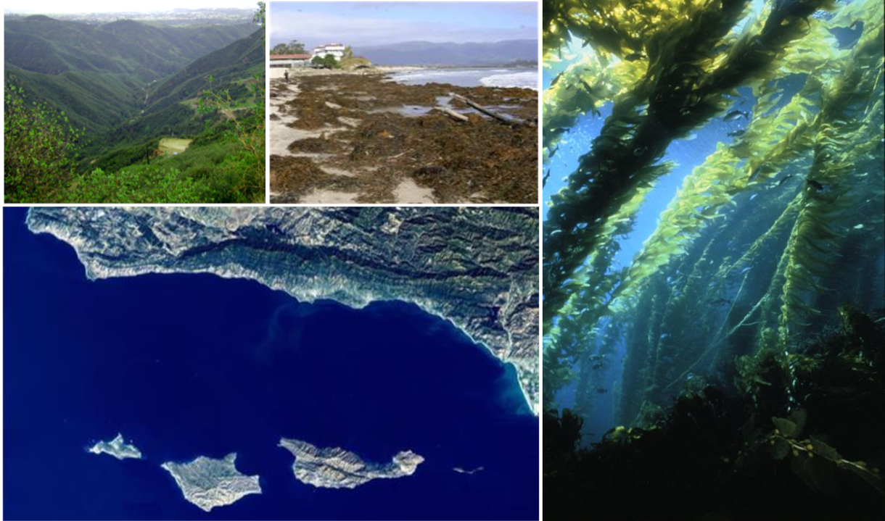
SBC III: Synthesis and Future Plans
Marine Science Institute
University of California Santa Barbara

Slide 2
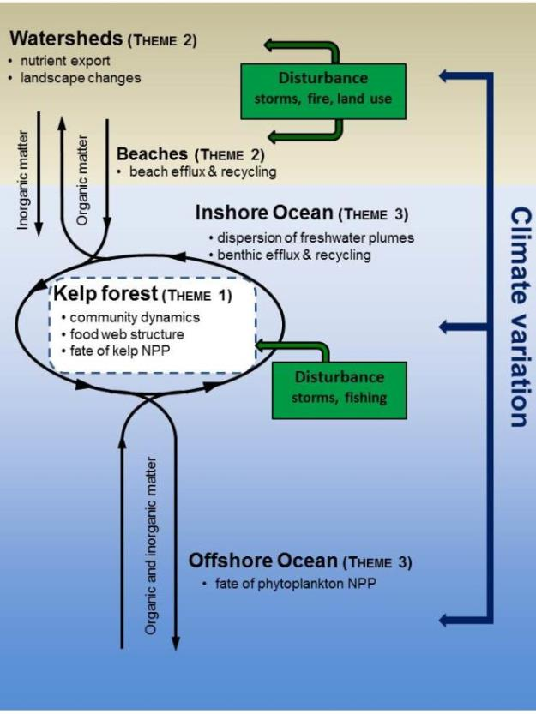
SBC III: 2012-2018
Conceptual Framework
Focus:
Determine how the structure and function of kelp forests and their material exchange with adjacent land and ocean ecosystems are altered by disturbance and climate
Notes:
Focus of material exchange on N and organic matter

Slide 3
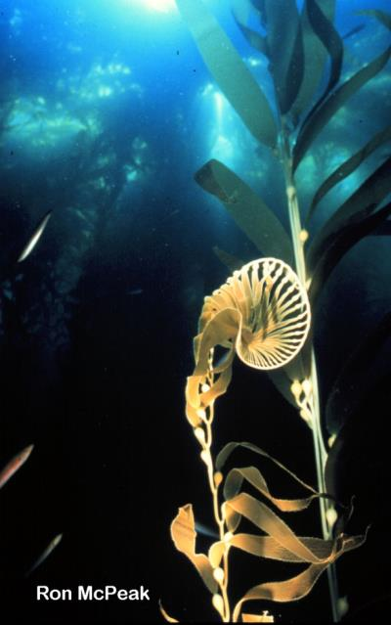
SBC III: Material Exchange - Nitrogen
Kelp growth occurs year round
Limited capacity for N storage
Requires N from multiple sources to sustain growth
Nitrate considered dominant form of N limiting micro- and macroalgal growth in Southern California Bight
Notes:
An element that integrates our research is the year round growth of giant kelp

Slide 4
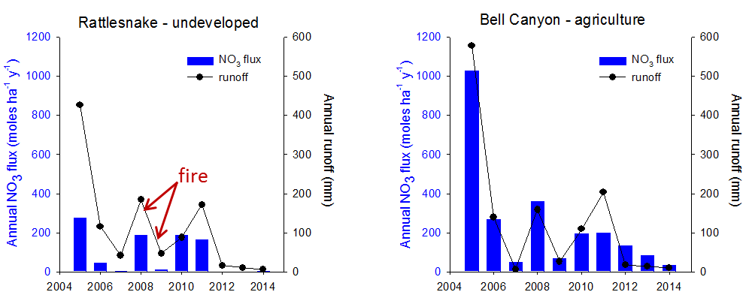
N supply from land
SBC III results show:
Nitrate fluxes vary greatly across the landscape in response to land use, land cover, and fire history
Nitrate fluxes vary greatly over time within runoff events, among events within the same year and among years

Slide 5
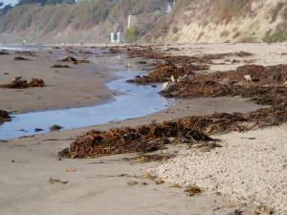
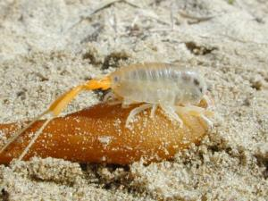
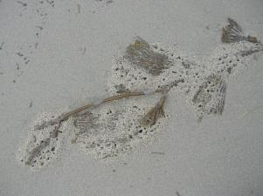
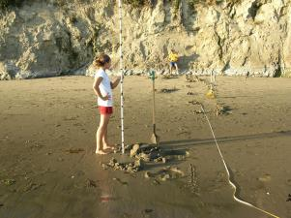
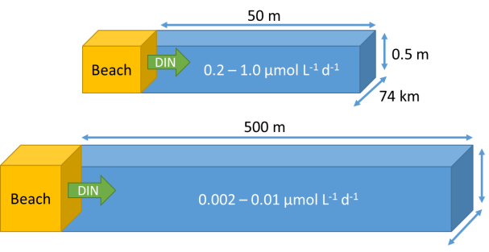
N supply from beaches
SBC III results show:
High concentrations of dissolved N in beach pore water related to kelp wrack accumulation and consumption by beach detritivores
Elevated DIN concentrations in waters adjacent to beaches with accumulated wrack
Beach contribution to coastal DIN supply quickly diluted
Notes:
High concentrations of dissolved N in beach pore water related to kelp wrack accumulation and consumption by beach detrivores
Water sampling and isotope analyses of macroalgae show elevated DIN concentrations in waters adjacent to beaches with accumulated wrack
Calculations based on porewater turnover time and volume indicate beach contribution to coastal DIN supply quickly diluted and elevated concentrations are limited to ~50 meters from shore

Slide 6
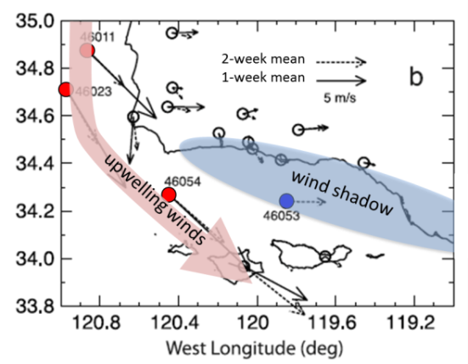

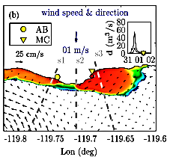
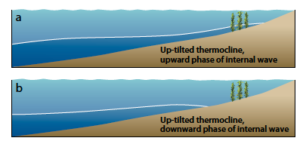
N supply from the ocean
SBC III results show:
Wind-driven upwelling is weak and intermittent near shore
Winds and local circulation affect the delivery of freshwater N to the kelp forest
Along-shelf and cross-shelf flow mechanisms primarily responsible for delivering marine N to kelp forests
Notes:
coastally trapped waves generated off Baja California cause thermocline tilts and upwelling-like flows

Slide 7
Nitrate supply to kelp forests
SBC III results show:
Multiple marine and terrestrial sources of NO⁻₃ are insufficient to sustain kelp growth for 4 – 6 months of the year
Values are daily means averaged over 2002-2012
Lower limit needed to sustain kelp growth
Notes:
Stacked bar graph of daily means of the concentrations of NO₃ in the nearshore delivered by different processes averaged over.
Unexplained rpare backg

Slide 8
Remineralization and recycling
Ammonium generated by remineralization and recycling may supply the N needed by kelp during summer and autumn
Data are monthly means (2002 - 2014)
Lower limit needed to sustain kelp growth
NH₄ ≥ NO₃ + NO₂ in summer and fall
Total DIN ≥ lower limit needed for kelp growth
NH₄ highest near the bottom
NH₄ highest in the morning
Notes:
Concentrations of ammonium are greatest near the bottom suggesting a benthic source
Highest in the morning which is suggestive of rapid consumption with increasing light

Slide 9
Marine and terrestrial POM may serve as sources of recycled N in sediments
March
August
Purple sea urchin
Ornate tube worm
Stream
POM
Marine alga
low
high
low
high
Exposure to runoff
Terrestrially-derived POM is broadly distributed in nearshore sediments
Remineralization could provide a benthic source of N to nearshore producers
¹⁵N-enrichment in the reef consumers increases with exposure to runoff
Terrestrial N may enter kelp forest food web via trophic intermediary
Notes:
Terrestrially-derived POM is broadly distributed in nearshore sediments
Remineralization of this material could serve as source of N to nearshore primary producers
N in kelp forest consumers may be a mixture of marine and terrestrial sources
¹⁵N-enrichment in the sea urchin Strongylocentrotus purpuratus and the annelid Diopatra ornata) increases with exposure to runoff
Suggests terrestrial N enters kelp forest food web via trophic intermediary (e.g. algae or detritus)

Slide 10
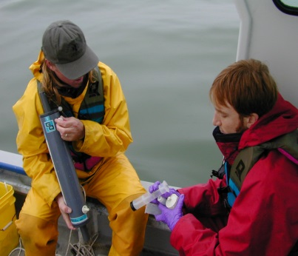
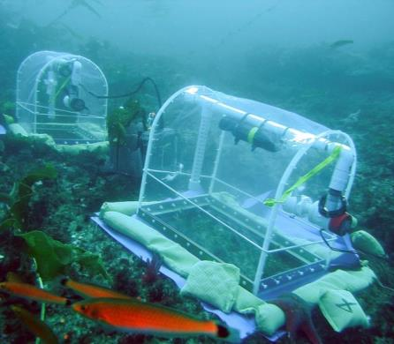
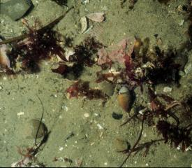
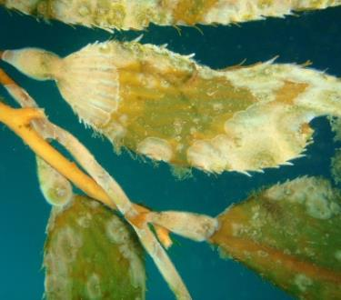
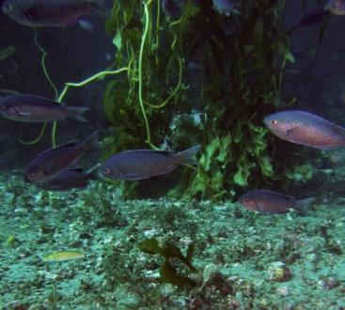
Planned Research – N recycling in kelp forests
Initiate sampling to characterize spatial and temporal variability in NO₃, NH₄ and DON
Measure efflux of DIN and DON from bottom
Distinguish benthic vs. water column and marine vs. terrestrial sources of N
Measure excretion by epiphytic and epibenthic consumers
Notes:
Initiate time series to characterize spatial and temporal variability in NO₃, NH₄ and DON
Measure efflux of DIN and DON from bottom
Measured estimates using benthic chambers
Calculated estimates using measurements of pore water concentrations and bottom turbulence
Make use of gradients in stable isotope signatures to distinguish benthic vs. water column and marine vs. terrestrial sources of N
Measure excretion by epiphytic and epibenthic consumers

Slide 11
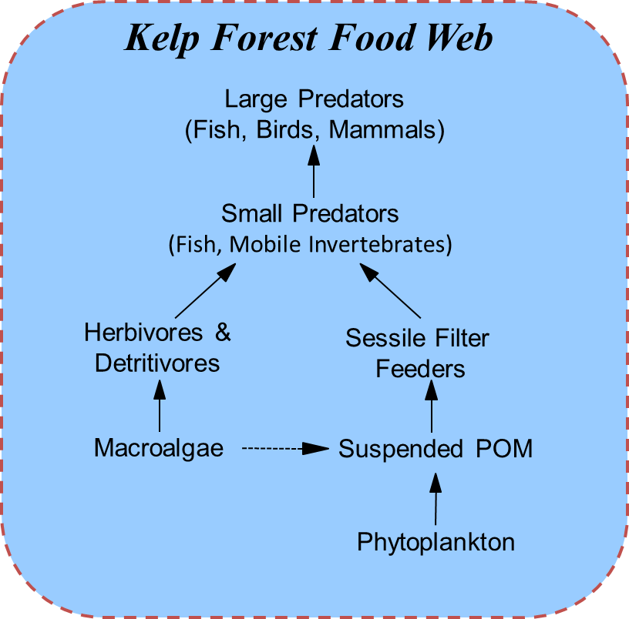
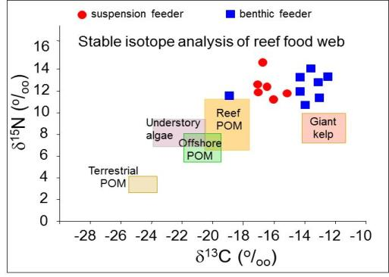
SBC III: Material Exchange – Organic matter
Two trophic pathways in kelp forest food web
Benthic production fueled by macroalgae
Planktonic production fueled by phytoplankton
?
Page et al. 2008
Stable isotope signature of Reef POM is intermediate between Offshore POM (i.e. phytoplankton) and giant kelp
A common assumption is that kelp contributes to reef POM and thus fuels both pathways in the food web

Slide 12
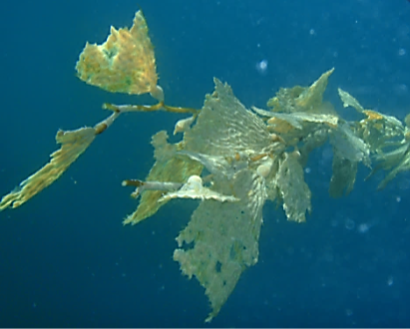
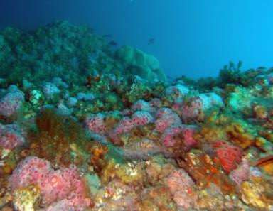
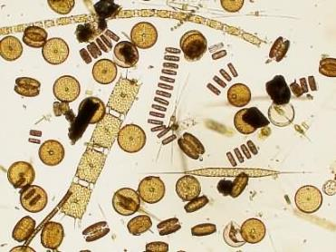
SBC III: Material Exchange – Organic matter
SBC III results show:
d¹³C of reef POM unrelated to the biomass of giant kelp
Kelp POM is small fraction of reef POM
Growth of suspension feeders unaffected by suspended kelp detritus
Conclusion:
Kelp forest suspension feeders rely on ex situ production of phytoplankton
Variability in d¹³C of reef POM linked to phytoplankton NPP
Notes:
Time series data reveal d¹³C of reef POM unrelated to the biomass of giant kelp (Page et al. 2008)
Kelp derived POC represents a very small fraction of reef POM (Yorke et al. 2013)
Growth of suspension feeders unaffected by suspended kelp detritus (Yorke in prep)
Giant kelp does not contribute significantly to the planktonic pathway of the kelp forest food web (Miller and Page 2012)
Kelp forest suspension feeders rely on ex situ production of phytoplankton (Miller et al. 2011, Miller et al. 2013)
High variability in d¹³C of reef POM linked to phytoplankton NPP (Miller et al. 2013)

Slide 13
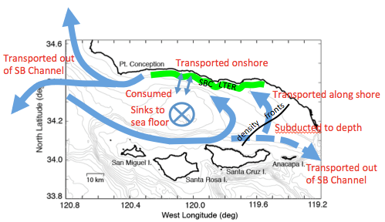
Fate and transport - Phytoplankton NPP
SBC III results show:
Some phytoplankton NPP subducted offshore at fronts
Phytoplankton transported inshore by variety of cross-shore processes
Strong relationship found between suspended matter distribution & surface waves
Nearshore, alongshore transport >> cross-shore
Transport near headlands >> transport near embayments
Evolving picture of fate and transport of phytoplankton NPP
Notes:
Cross-shore processes (upwelling, internal waves, eddies) can rapidly transport offshore phytoplankton to kelp forests (Brzezinski and Washburn 2011, Washburn and McPhee Shaw 2013)
Some offshore phytoplankton NPP is removed from the euphotic zone by water mass subduction at convergent density fronts (Washburn et al. in review)
Cross-shelf processes extend to shore during periods of mixing (winter and spring), but dissipate during stratified conditions (late summer and fall) causing the inner shelf to become isolated from offshore (Halewood et al. 2012, Goodman et al. 2012)
Inshore transport of phytoplankton during blooms coincides with sediment loads and surface waves (Henderikx-Freitas et al. in review)
Close to shore, alongshore transport > crosshore transport, and slower near embayments compared to headlands (Romero et al. 2013)

Slide 14
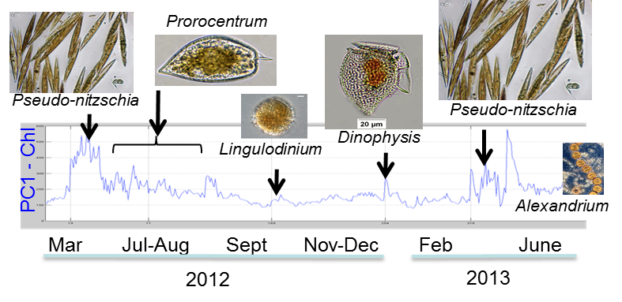




Planned Research – Phytoplankton fate and transport
Place SBC phytoplankton dynamics in regional context using satellite data
Examine controls on cross-shore distributions of suspended particles & phytoplankton
Assess the importance of different phytoplankton groups to coastal suspension feeders
Notes:
I put down some on-going work. The satellite image is the long-term correlation coefficient between proxies for suspended particles and phytoplankton – note the poor correlation strip in the nearshore
Assess the importance of different phyto types to POM and suspension feeders. We have 90% of the data for the initial study in hand and will be publishing in the coming year on this.

Slide 15
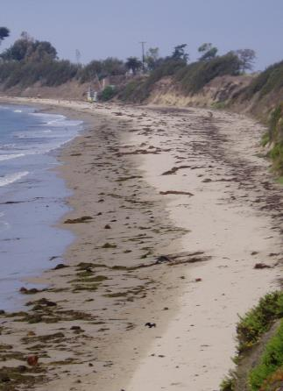
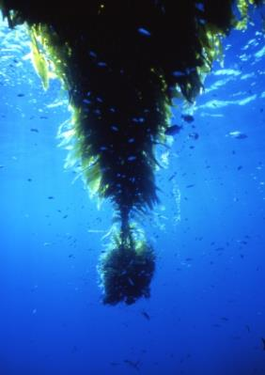
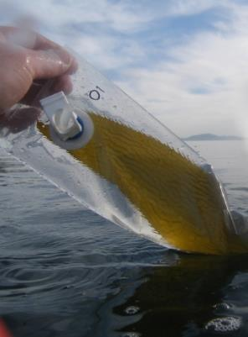

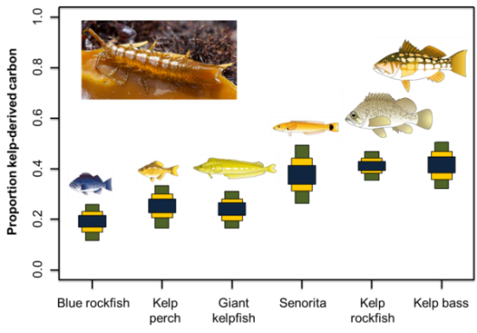
Fate and transport - Giant kelp NPP
SBC III results show:
14% of kelp NPP lost as DOM
Biomass lost as fronds exceeds that lost as whole plants
Kelp is critical to beach food web and biochemical cycling
Kelp is an important source of dietary C for invertebrate grazers & fish predators
Senescence best explains frond demographics
Notes:
SBC results show:
High biomass turnover and the amount lost as as fronds exceeds that lost as whole plants
programmed senescence rather than environmental factors best explain frond demographics (Rodriguez et al. 2013)
14% of kelp NPP lost as dissolved organic matter (Reed et al. 2015)
Microbial remineralization experiments show 70% of kelp DOC remains available to heterotrophic bacteria after 31 days (Carlson et al. unpublished)
Isotope analyses show giant kelp is an important food source for kelp forest invertebrate grazers and the fish predators that feed on them (Koenigs et al. in press)
Exported kelp is critical to beach food webs and their biochemical cycling (Dugan et al. 2011, 2013, Goodrige and Melack 2014)

Slide 16
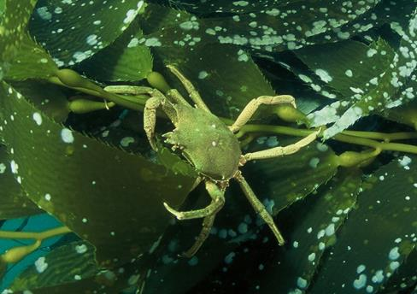
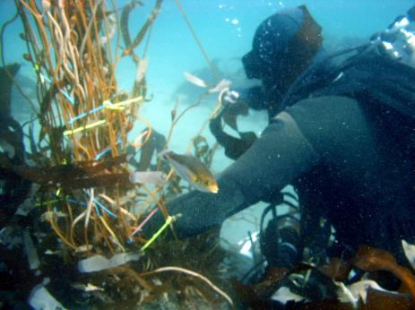
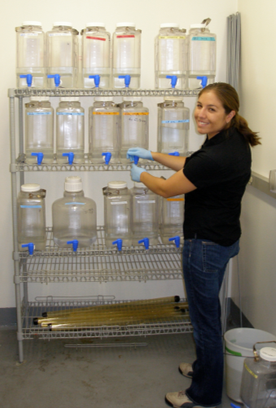
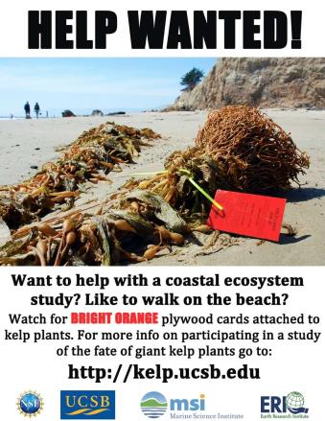
Planned Research – Kelp fate and transport
Incorporate losses due to exudation, senescence & grazing into estimates of kelp NPP
Quantify the amount of kelp NPP consumed by forest grazers
Microbial remineralization experiments to determine the fraction of DOC export that is bioavailable
Expand studies of kelp loss to quantify processes affecting the delivery and retention of kelp wrack on beaches

Slide 17
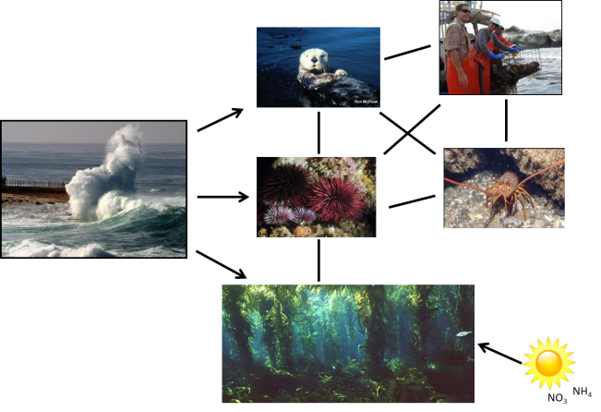
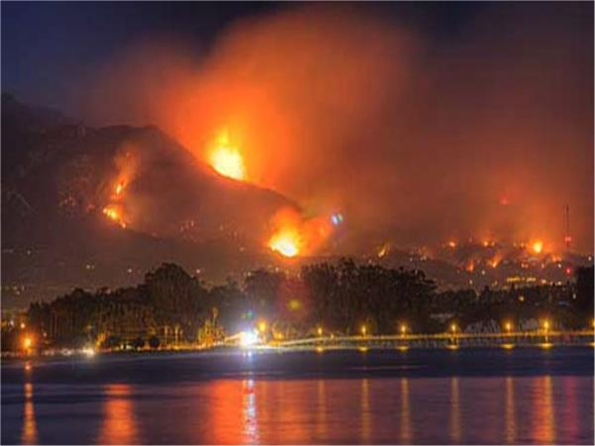
SBC III: Disturbance
Disturbance from waves and fishing interacts with bottom-up and top-down forcing to control primary production and the trophic structure of kelp forests
Fire affects materials delivered to the ocean from land by drastically altering land cover, organic matter, soil chemistry, runoff and erosion

Slide 18
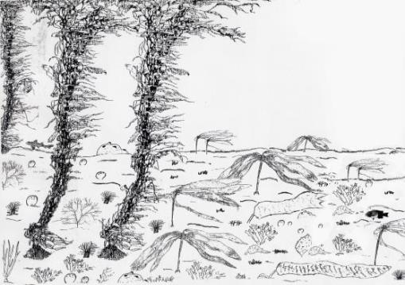
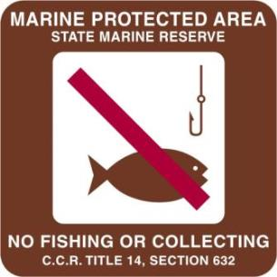
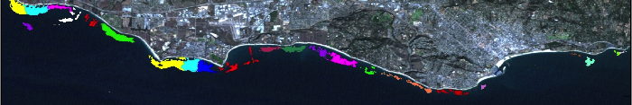
SBC III: Disturbance – Kelp forest
SBC III results show:
  Grazing and sedimentation can mask effects of annual kelp loss from winter storms
  Annual kelp loss leads to large changes in community structure, but not community NPP
Long-term experiment
Landsat kelp cover
Kelp patches
Recovery of local populations of giant kelp dependent on connectivity with other local populations
Population fecundity not dispersal drives connectivity
  Rapid numerical responses and delayed behavioral responses in the absence of fishing
Notes:
SBC results show:
Wave disturbance often overwhelms top-down and bottom-up processes in controlling the biomass dynamics and NPP of giant kelp (Reed et al. 2011, Cavanaugh et al. 2013, Bell et al. 2015)
Recovery of local populations of giant kelp dependent on connectivity with other local populations (Cavanaugh et al. 2013, Castorani et al. in press)
Simulations using long-term data suggest kelp forest food webs become less diverse and less complex with high frequency of wave disturbance (Byrnes et al. 2011)
Results from long-term disturbance experiment show:
Localized effects of grazing and sedimentation can mask effects of annual kelp loss from winter storms
In the absence of other disturbances, the annual loss of kelp alters the biomass and diversity of producers and consumers, but has smaller effect on community NPP due to compensation by other macroalgae
Disturbance from fishing based on studies within and outside of MPAs show:
Rapid numerical response by kelp forests consumers and producers in the absence of fishing.
Delayed behavioral changes in foraging behavior of lobster predators in response to greater competition for food

Slide 19
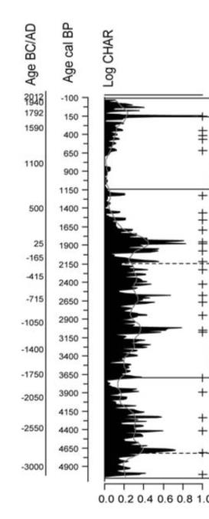
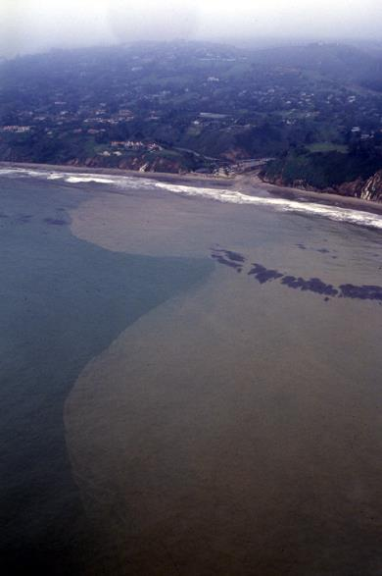
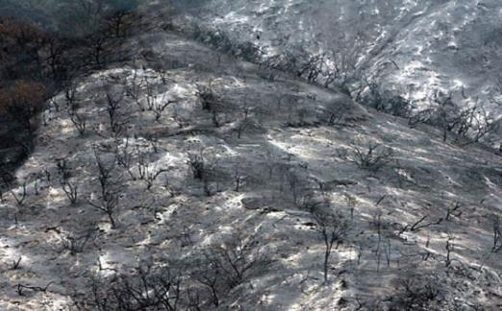
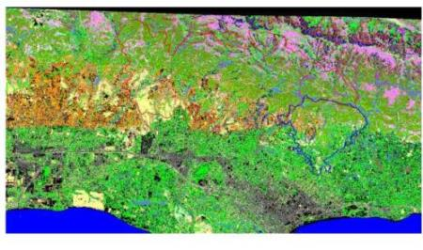
SBC III: Disturbance – Coastal Watersheds
SBC III results show:
Fire frequencies and sedimentation rates have changed since pre-Spanish times
Fire alters soil chemistry to influence N cycling in chaparral ecosystems
Recovery times of the landscape following fire depends on the timing and amount of precipitation
Fire increases the flux of suspended particles delivered to the ocean by coastal streams
Notes:
SBC results show:

Slide 20
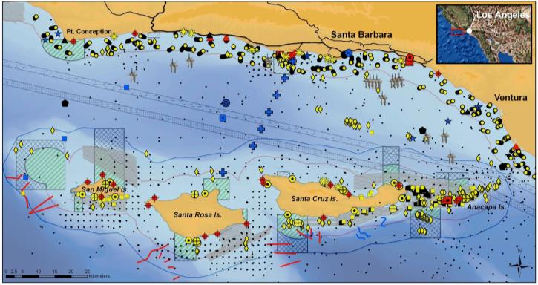
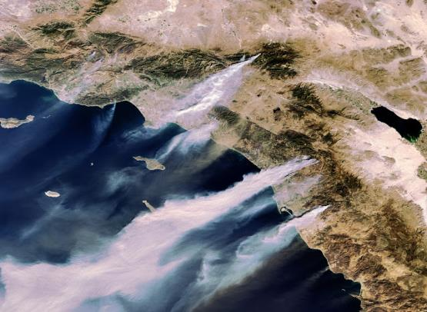
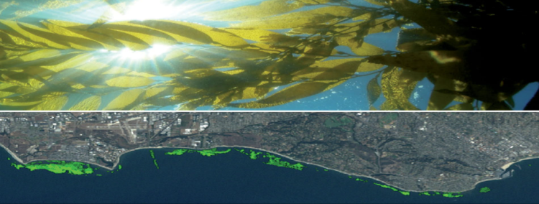
Planned Research – Disturbance
Continue sampling to evaluate trajectories of community change in response to fire, kelp loss & fishing
Research partners in the SB Channel
Integrate SBC data with data from collaborative partners to evaluate broader scale impacts of wave disturbance & fishing
Determine how wave disturbance interacts with connectivity to explain the biomass dynamics of giant kelp
Notes:
Continue sampling long-term disturbance experiment and MPAs to evaluate trajectories of community change in response kelp loss and fishing
Integrate SBC kelp forest community data and those of collaborative partners to evaluate the effects of wave disturbance over spatial and temporal scales that are greater than that covered by SBC alone.
Use regional data (e.g., Landsat, ocean color, swell ht) to determine how disturbance and connectivity explain the biomass dynamics of giant kelp

Slide 21
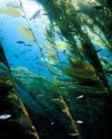
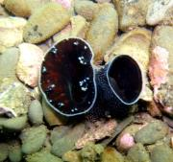
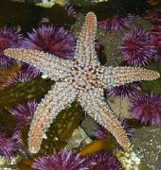
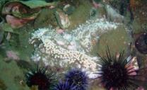
SBC III: Climate variation
SBC is currently experiencing unprecedented changes in climate
Pacific sea star disease spread north to south from Alaska to Baja, Mexico

Slide 22

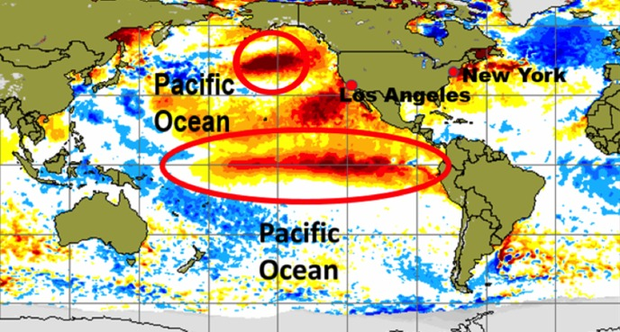
Onset of a very strong ENSO event is coinciding with ongoing Pacific anomalies
Potential consequences to SBC include:
Floods, erosion, large waves, elevated SST, depressed ocean productivity, altered ocean currents, changes in species distributions
Altered material exchange among coastal ecosystems

Slide 23
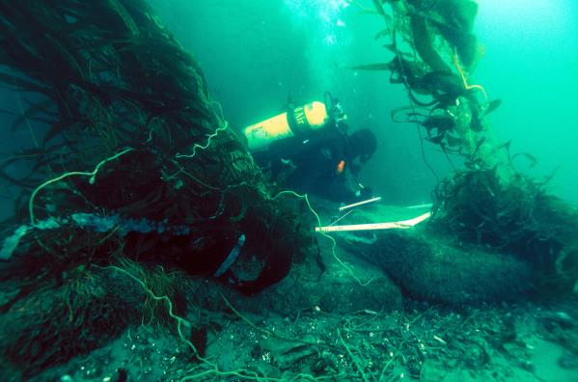



Planned Research – Climate variation
Maintain core time series data for future analyses on patterns and ecological consequences of changes in climate
Evaluate effects of climate variation on biodiversity, community structure and watershed fluxes across different temporal scales using integrated data
Targeted new sampling to capture specific events and processes
Notes:
Maintain core time series data for future analyses on patterns and ecological consequences of changes in climate
Implement new targeted sampling designed to capture consequences of specific events or processes: intense rainfall, runoff with high particulates and nutrients, storms, high temperatures
Integrate data from SBC and collaborative partners to evaluate the effects climate variation on biodiversity, community structure and watershed fluxes across different temporal scales (El Nino, PDO etc)

Slide 24





Questions?

